Slide 1
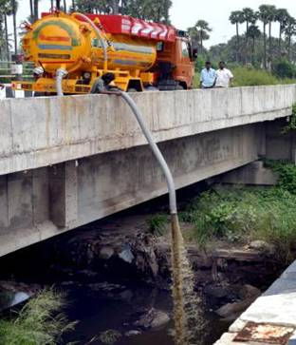
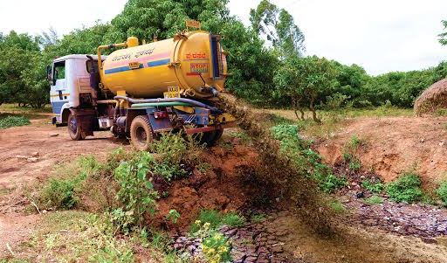
Fecal
Sludge Management

Slide 2
Policy Goals of Sanitation
Advantage & Disadvantage of Toilets & Pits
Public Health : Especially Children
Environment : Especially lakes
Inconvenience : Visual and smell
Safety : Especially for women
Toilet (without treatment) addresses successfully the last two problems but unintentionally increases the first two
Problem of sanitation does not end, but starts after building toilets + urbanization

Slide 3
FSM
By 2020, 70% of urban toilets will have on-site storage (tanks, pits)

Slide 4
Overview of Characteristics
FS is almost 100x more polluting than Sewage:
Characteristics vary widely based on location, season and type of containment tank
Characteristic | Raw Sewage | Faecal Sludge
BOD (mg / L) | 110 – 350 | 10,000 – 36,000
COD (mg / L) | 250 – 800 | 25,000 – 100,000
TSS (mg / L) | 120 – 400 | 10,000 – 40,000

Slide 5
A solution - FSTP plant, Devanahalli
6 KLD – 615 sqm – 60 lakhs – 4.5 lakhs

Slide 6
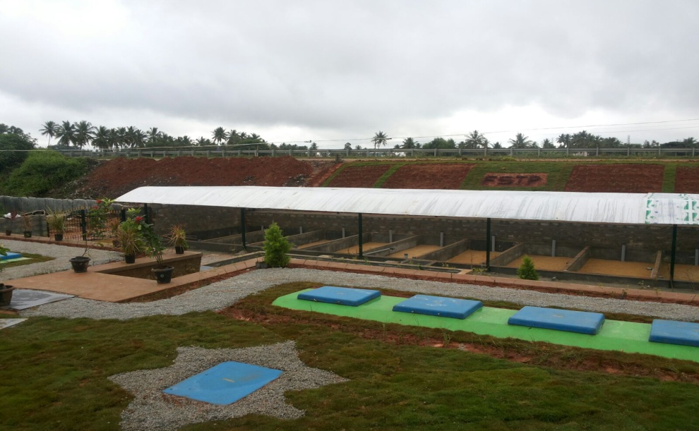
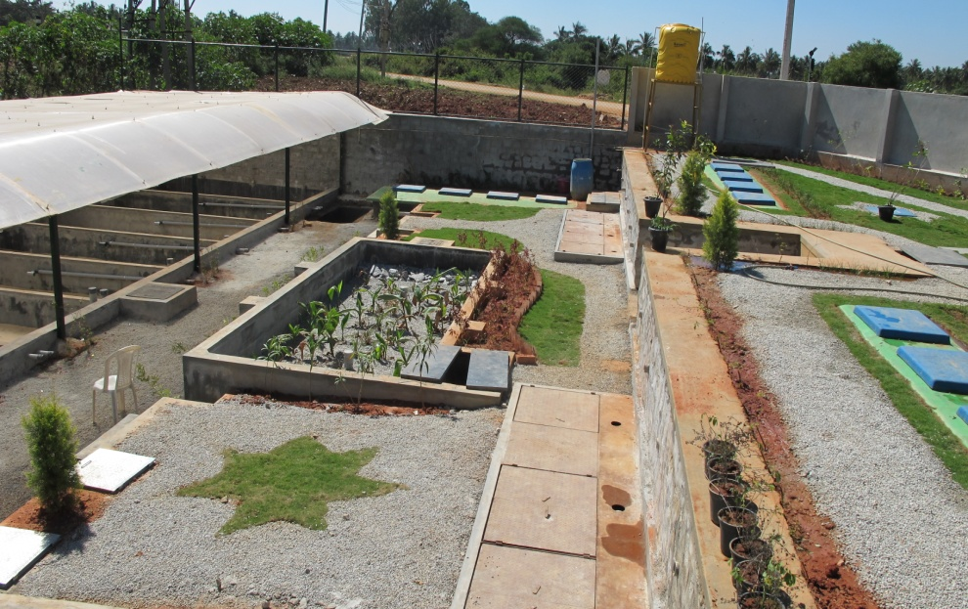
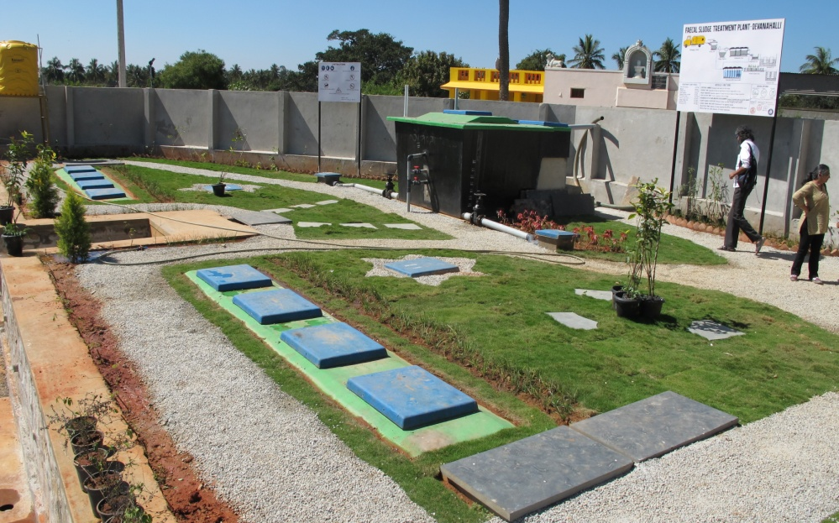
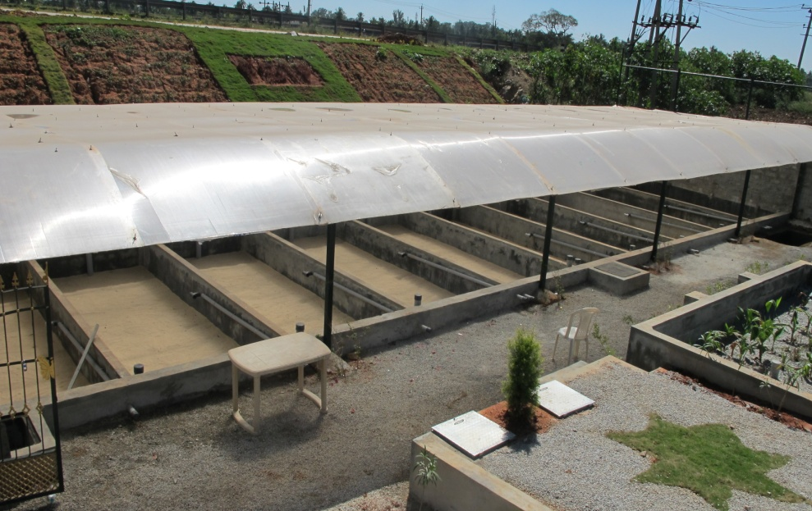
FSTP Devanahalli

Slide 7
Financial Overview
Quick, Reliable
Implementation
Affordable
CapEx
Low
OpEx
< 1 year
No complex failure modes
20x
Cheaper than UGD
(< Rs 500 per capita)
Pop. 100,000 = Rs 5Cr.
Rs 2.50 / capita / month
Pop. 100,000 = Rs 30 Lacs / year
Govt. Funds
PPP
User fee - desludging
Sale of sludge
Tipping Fees
ULB Budget
Water / Property Tax
Over time, can become self-sustaining for ULB

Slide 8
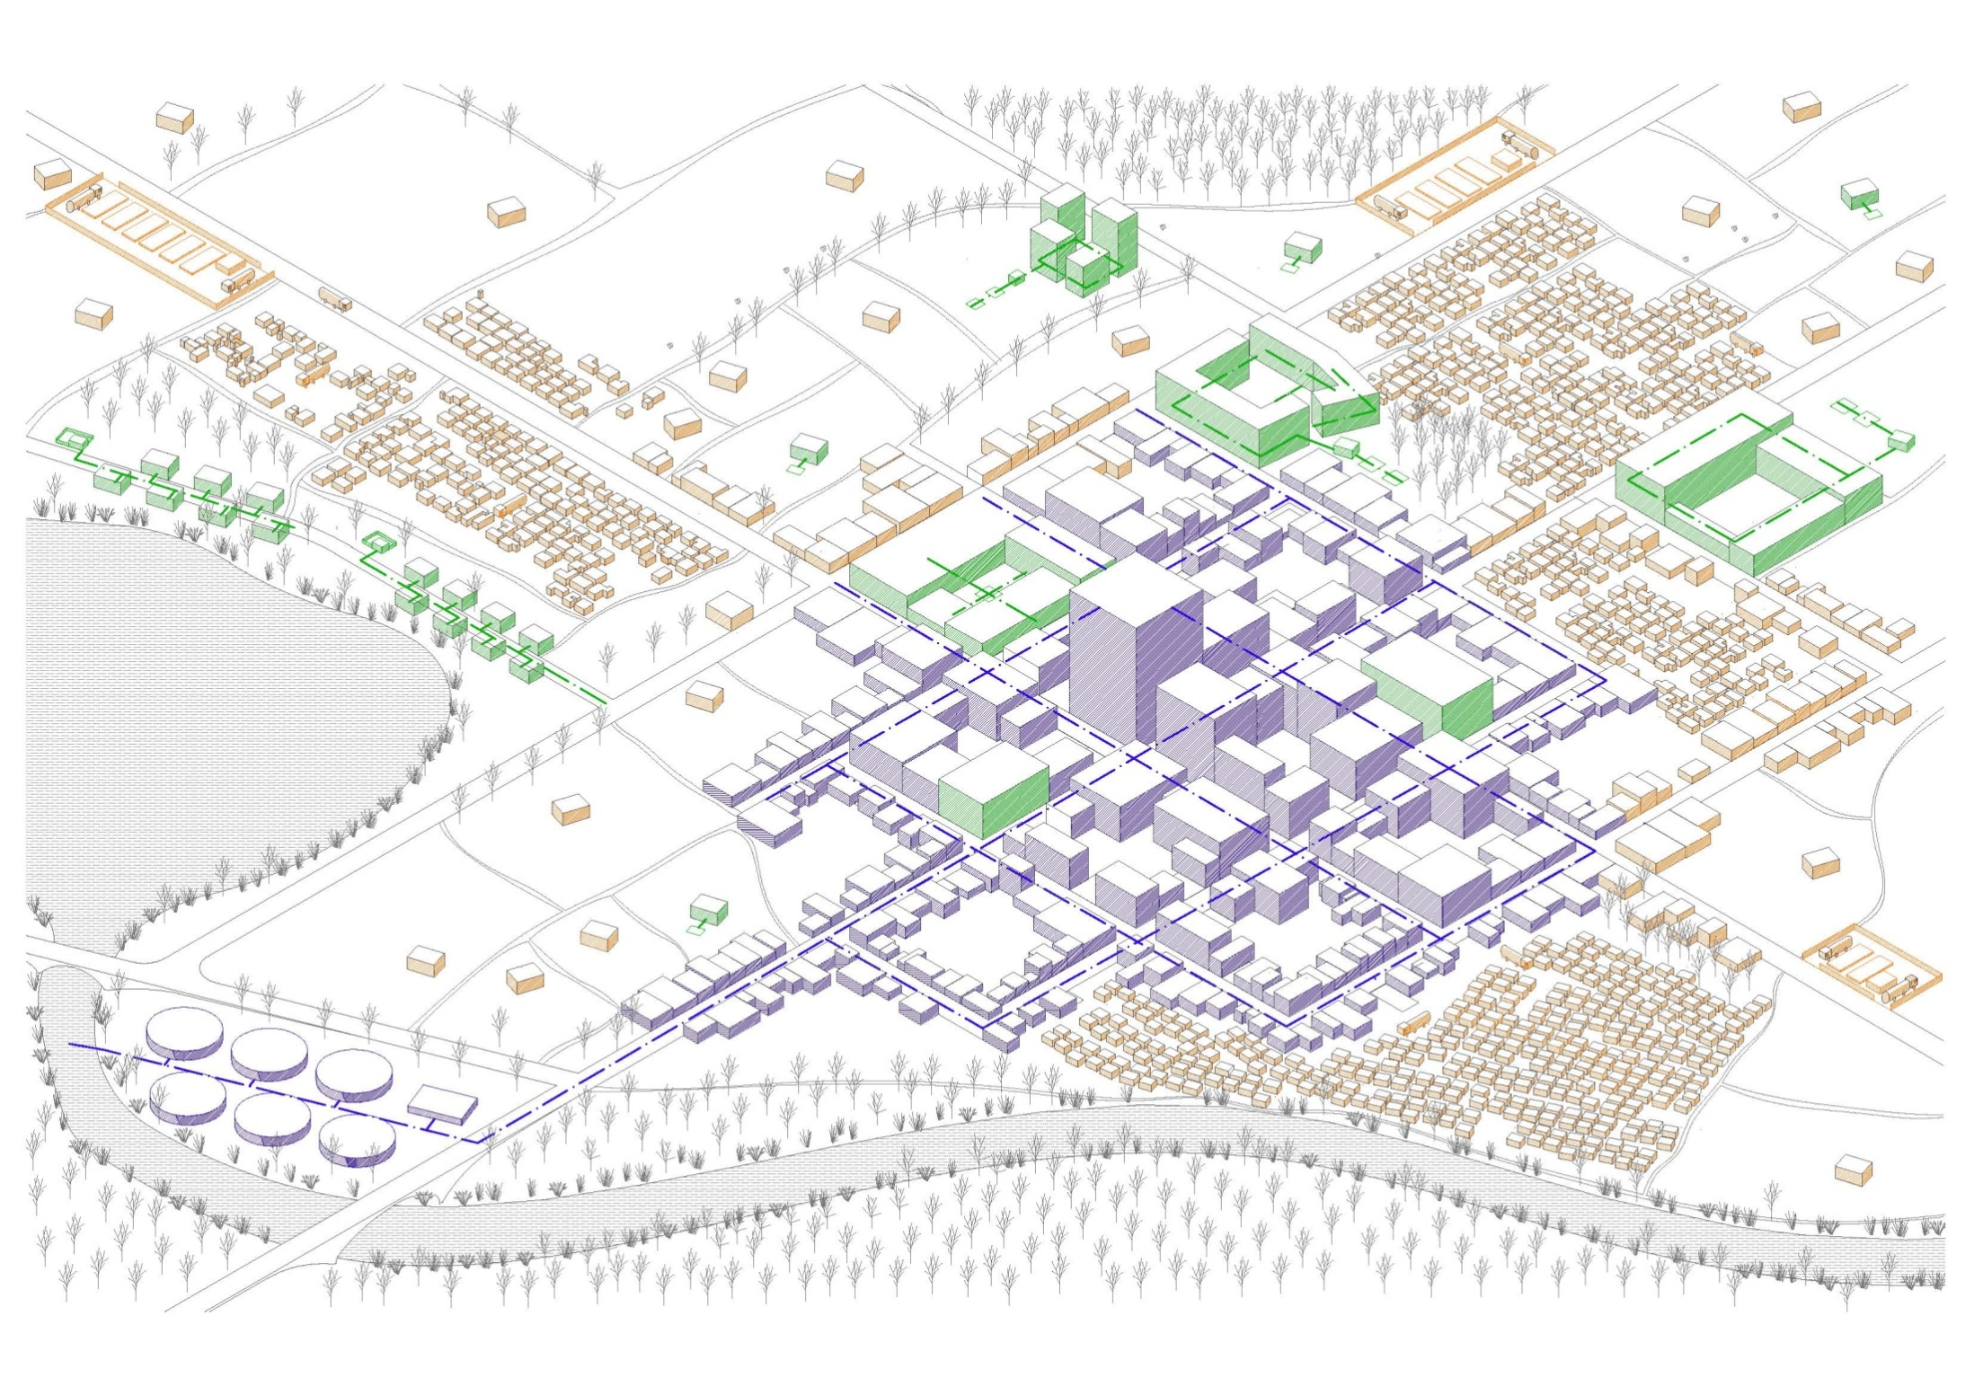

Slide 9
Wastewater Infrastructure
7,000 towns with 400 Million people (600Mn by 2030)
All cities need combination of approaches to solve challenge:
Approach | Notes | Cap Ex per Capita
1. Centralized Sewerage Systems | Difficult and disruptive Many failed / partial treatment | Rs 20,000 [pop 200,000= Rs 400Cr]
2. De-centralized Wastewater Treatment Systems | Implement in phased manner Local re-cycling of water Regulations—bulk generators invest | Rs 4,000 – 6,000 [Rs 100Cr]
3. Faecal Sludge Management | Very simple, quick and low cost Need good logistics operations Technical skills not easily available | Rs 750 [Rs 15Cr]

Slide 10
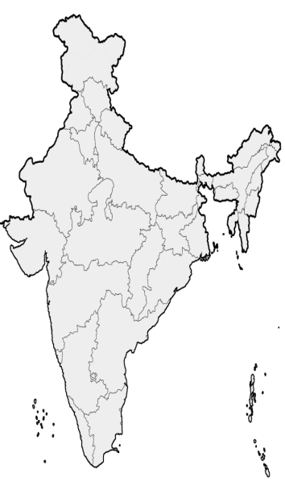
FSM so far …
J&K: Leh; Srinagar; Jammu
UP: Jhansi, Unnao, FSM TSU
RJ: State policy; 100 towns FSM
JH: 6 AMRUT cities; FSM statewide
MH: CSR for FSM; Technology validation for FSM scale-up
Orissa: 9 AMRUT cities; FSM PMU for scaling up
AP & TL: 76 + 70 ULBs for FSM tendered
KA: FSM under AMRUT; 50 towns budgeted for in 2018;
TN: Pioneer in FSM in the country; Large scale FSM intervention in progress

Slide 11
Question 1
If we can spend enormous social and political capital to become ODF
Why not
the same effort on preventing unsafe disposal of FS?

Slide 12
Question 2
If we truly want to eradicate
Manual Scavenging
Why not
invest more in dignified ways of emptying pits/tanks?

Slide 13
Question 3
If we truly believe in social and economic equity
Why not
invest more in FSM – provide basic sanitation for all, quickly?

Slide 14
Thank You

