Slide 1
Urban Development and Housing Department
Government of Madhya Pradesh
AMRUT
in
Madhya Pradesh
Lucknow,
Dated 27th July, 2018

Slide 2
Details of SAAP
34 Cities covered under the Mission.
5 year Perspective Plan for Project size of Rs. 6459.78 Cr.
Projects Under SAAP

Slide 3
State initiative- Funding Pattern

Slide 4
Implementation Arrangements
AMRUT in MP
Project Preparation by Towns through qualified Consultants.
Project appraisal by SLTC chaired by Mission Director and SHPSC chaired by the C.S.
Project Implementation by Towns under closed supervision of State PMU.
Fully Transparent e-procurement of works by ULBs on standard Bidding Document having clear and objective qualification condition and post construction maintenance.
Two consultancy organizations working as PDMC for supervision and quality control under Engineer in Chief.
Third party monitoring by IRMA consultant.

Slide 5
State Initiatives
AMRUT in MP
Water Supply
Consequent to study existing water supply facility, DMA restructuring of Towns including gaps in distribution network and treatment facility taken up.
Complete town covered by PLC and SCADA from source to DMA for quantity and quality monitoring.
O & M for complete town built up in the projects for 5 years after completion.
Financial approval of projects by calculating IRR and cities are required to change user charges so calculated.

Slide 6
State Initiatives
AMRUT in MP
Sewerage Projects
Conventional methodology of drain tapping and sewage pumping to STP discontinued. Conventional designing of centralized sewer network involving multiple pumping reviewed.
In all Sewerage Projects the work starting from house service connection to Sewage Treatment Plant are being taken up based on geographical zoning.
Decentralized or semi–centralized STPs to ensure gravity flow with no-pumping/ bare minimum pumping.
10 years post construction O & M inbuilt in the projects.
Technology free tendering with defined out put parameters. Bid criteria is CAPEX+ (10 years O & M + Power guarantee) with NPV discount factor financial approval of projects by calculating IRR and cities are required to change user charges so calculated.

Slide 7
Progress
AMRUT in MP
(Rs. in Crores)
Sector | Sanctioned Projects |  | Work Completed |  | Under Progress |  | Under Tendering |  | Expend-iture
 | City (Projects) in Nos | Amount | City (Projects) in Nos | Amount | City (Projects) in Nos | Amount | City (Projects) in Nos | Amount
Water Supply | 20 (29) | 2115.8 | 03 (05) | 89.99 | 17 (23) | 2015.81 | 01 (01) | 10 | 657.36
Sewerage and Septage Management | 20 (24) | 3580.2 | 01 (01) | 66 | 19 (23) | 3514.2 | 0 | 0 | 415.67
Drainage | 08 (08) | 202.35 |  |  | 06 (06) | 179.47 | 02 (02) | 22.88
Urban Transport | 21 (32) | 241.93 |  |  | 15 (17) | 116.57 | 15 (15) | 125.36
Others (Parks) | 34 (92) | 105.59 | 10 (17) | 8.37 | 26 (60) | 70.34 | 12 (15) | 26.88 | 4.65
Grand Total | 34 (185) | 6245.87 | 10 (23) | 164.36 | 33 (129) | 5896.39 | 22 (33) | 185.12 | 1077.68

Slide 8
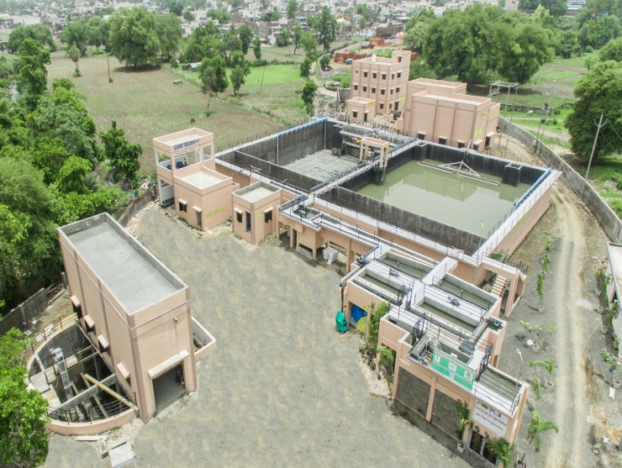
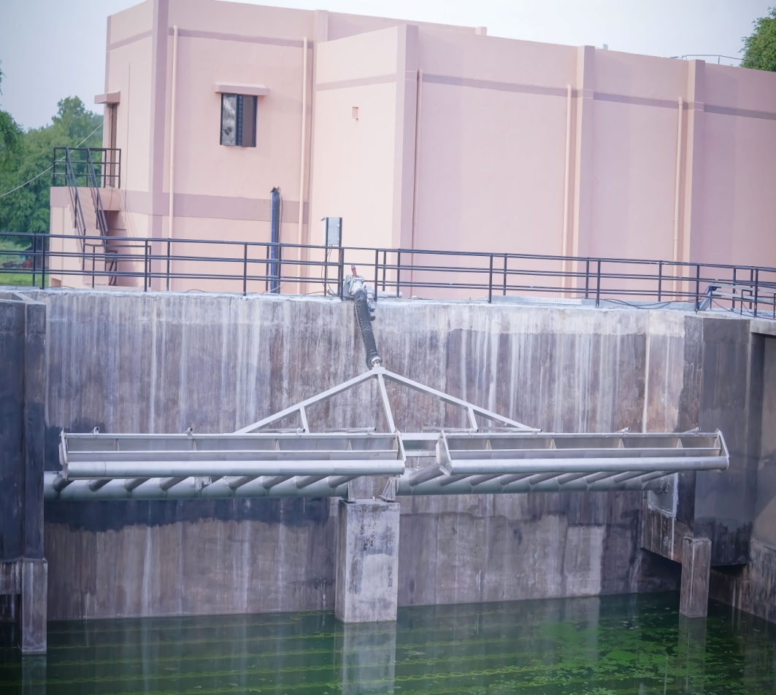
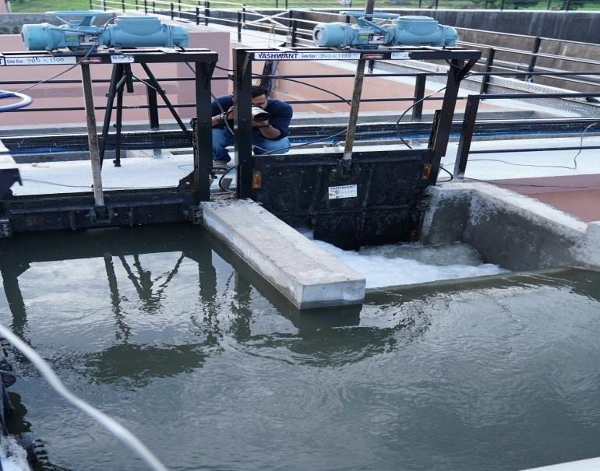
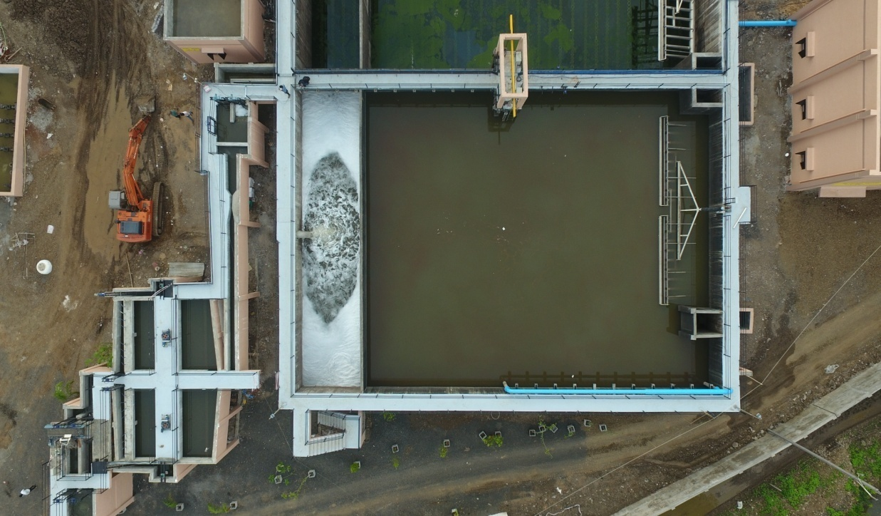
Sewage Project Sehore MP
AMRUT in MP

Slide 9
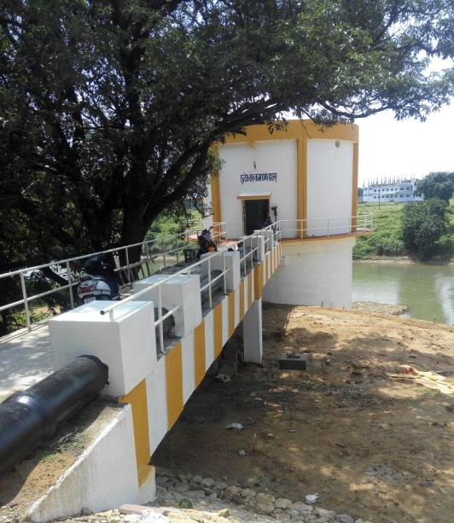
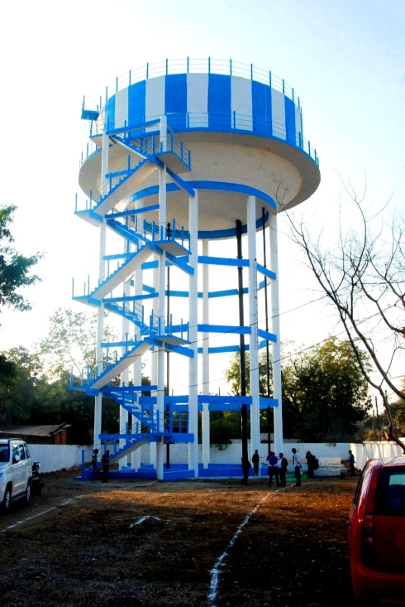
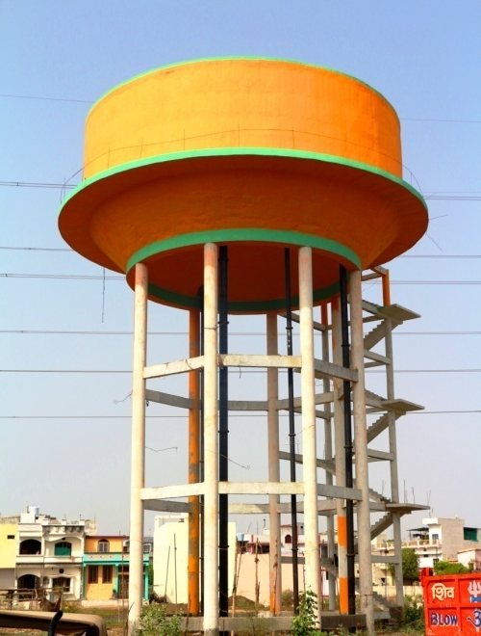
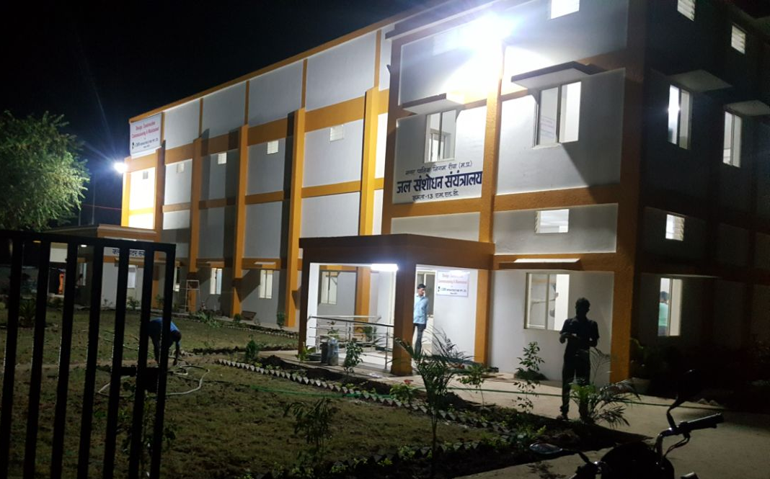
Water Supply Project Rewa MP

Slide 10
AMRUT in MP

