Slide 1
e-Governance Initiatives in Urban Local Bodies in Telangana State
Commissioner & Director of Municipal Administration Government of Telangana

Slide 2
Vision
To transform all cities in Telangana into livable, sustainable, inclusive, citizen friendly, environmentally acceptable and e-centric urban governance.

Slide 3
Objectives
To simply life for the citizens
To infuse accountability and transparency in the System
To improve Service Delivery in all ULBs of Telangana
To enable Ease of Doing Business
To leverage technology for achieving the above objectives

Slide 4
e- Urban Initiatives
Development Permission Management System (DPMS)
Property Tax assessment in DPMS system
Payment Gateways
Online Title Transfer
Property Mapping in the Urban Local Bodies – Land registry
GIS based Large Scale Base Maps
Citizen Services Monitoring System / Mobile Application
Web Services
Access to Services
M&E Dashboard
E-office
Awards
Way Forward -- E-Governance

Slide 5
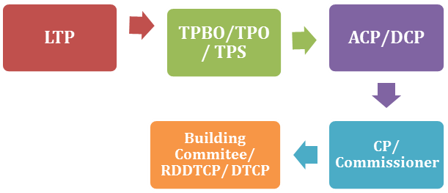
Development Permission Management System
Integrated-
TS-ipass,
Payment gateways,
Master plan,
Revenue records and SMS/Email
Features of DPMS
Common Applications Form
Joint Inspection Scheduler
Mapping of Restricted Areas
Auto DCR
Dashboard
Deemed Approval
Progress
49490 applications received
38915 approved
3200 rejected
Disposal – 89 %
Rs.210 Crs received through building permissions since 10.6.2016.

Slide 6
Assessment of Property Tax in DPMS system
New initiative-
Provisional Assessment of Property Tax is made at the time of building permission by integrating Online Building Permission System with Property Tax Module.
Citizen can make a self assessment through the Tax Calculator provided in mobile app and Web site.
Introduced payment gateways- Citizen can pay online payments without visiting municipal office and ULBs can have devolution of funds in T+3 days.

Slide 7
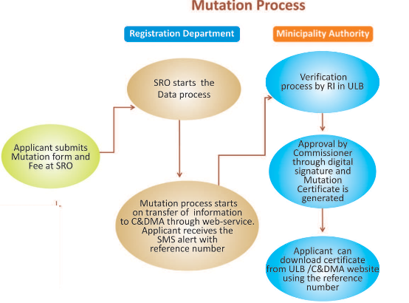
Online Title Transfer
Payment of mutation fee at the time of Registration
Capture of Property Information & automatic transfer of data.
Issue online certificate

Slide 8
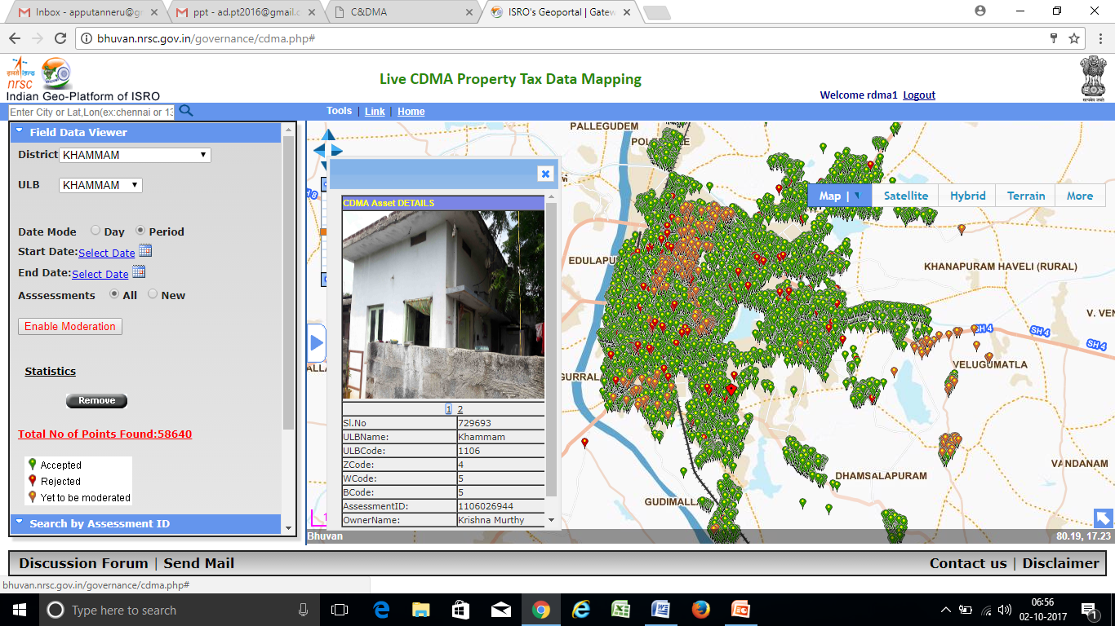
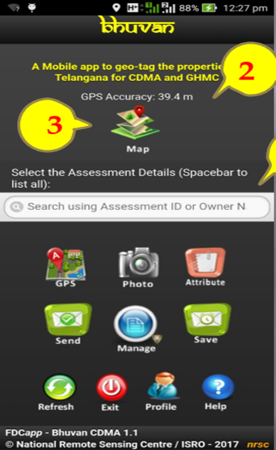
Property Mapping
Features
Developed Mobile app with NRSC
Integration with Bhuvan
Geo-tagging of properties with photographs
Integration with property data
Ownership
Property tax
Encumbrance
Disputes

Slide 9
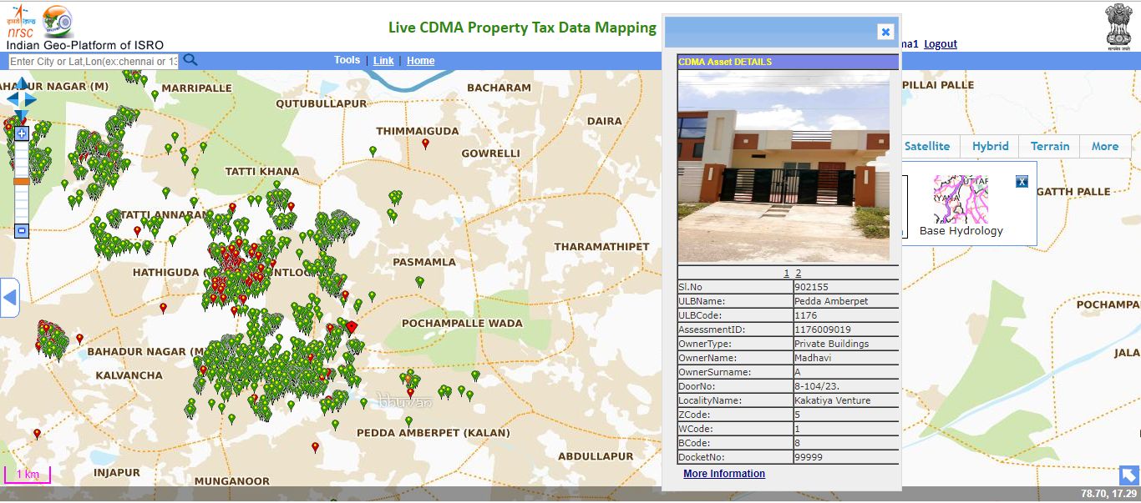
Integration of properties with GIS enabled photographs with details of owner, property tax, address and encumbrances, dispute and prohibited with the registration department database.

Slide 10
Property Mapping - Outcomes
12.5 lakh properties in the 72 Urban Local Bodies (ULBs) have been mapped using this process.
20100 new / un assessed properties are mapped in all the 72 ULBs and brought into tax net.
Geo-spatial data properties made available on the public domain and the citizens could view every detail information of the property online without visiting the ULB office.
Access to information online and ensure transparency, time bound and hassle-free services w.r.t property information
Validated the Bhuvan data with tax data base and found 42% variation.
Transformed the variation data into revenue model through un-assessed and under-assessed properties to an extent of Rs.27 Crores.

Slide 11
GIS based large scale Base map
Present project
Present Base Maps are prepared on 1:1000 scales.
Inputs are from High Resolution (0.5m) Satellite data, GPS & ETS based surveys.
Satellite data and GIS Technology based methods are followed.
44 Layers of different themes are generated.
Additional two layers of Property Tax data base and LED Street Lights are generated.
Special features
Geo-referenced Cadastral overlay – helps to know the Survey numbers pertaining to buildings/properties.
One meter contour maps provide the ground elevation model to plan water supply, network and to design, storm water, sewerage systems etc.
Unlike old maps, the present maps provide Latitude/longitude positions of all urban features.
Paid Service for Land Use is incorporated.

Slide 12
Thematic Layers
S.No | Satellite Based Layers | S.No | Survey Based Layers | S.No | ULB Input based layers
0 | Satellite image | 10 | Bus shelters | 27 | Municipal Boundary
1 | Buildings/Plots | 11 | Cell phone Towers | 28 | AOI
2 | Road Network | 12 | Community Toilet | 29 | Tax Zones
3 | Carriage way | 13 | DGPS Points | 30 | Ward Boundary
4 | Railway | 14 | Electric Transformer | 31 | Zone Boundary
5 | Streams/Drains/Canal | 15 | Fire Stations | 32 | Slum Boundary
6 | Bridges/Fly Overs | 16 | Garbage Collection Points | 33 | Colony Boundary
7 | Over Head Tanks | 17 | Hand Pump | 34 | Industrial Area
8 | Parks /Garden | 18 | Hoardings | 35 | Cadastral Map
9 | Foot Path | 19 | Land Marks | 36 | Slaughter House
 |  | 20 | Manhole | 37 | Vent Shaft
 |  | 21 | PowerSupply | 38 | LandfillSite
 |  | 22 | Street Light | 39 | Sewerage Network/ Drainage Network
 |  | 23 | Contours | 40 | Drainage Pumping Station
 |  | 24 | Traffic Square | 41 | Sewerage Treatment Plant/ Sewerage Pumping Station
 |  | 25 | Tube Well | 42 | Water Pumping Station
 |  | 26 | Telephone_Tower | 43 | Water Treatment Plant
 |  |  | Addl.Layers PBM (Permanent Bench Marks) Spot Hights , DEM (Digital Elevation Model), 3D Raster | 44 | Water Supply Network
 |  |  |  | 45 | Property Tax
 |  |  |  | 46 | LED street lights

Slide 13
3D View Water Supply - Sircialla
Drainage network: KARIMNAGAR

Slide 14
Other Utilities
ADILABAD MUNICIPALITY

Slide 15
Citizen Services Monitoring System
Services rendered through CSMS service centres and Mobile APP -
Access to Public Representatives and Staff directory of each ULB
View & Pay Tax Dues
Register & View Grievances
Know Service Request Status
Know your Service Person
Auto escalation
Download Applications
Timely Notifications from ULB
Media Coverage information
E-News
Imp contacts
Contact- office, social, web address

Slide 16
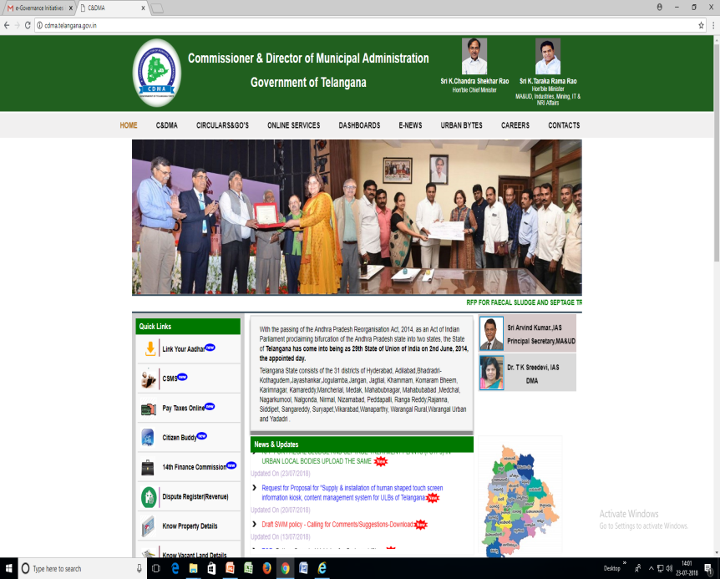
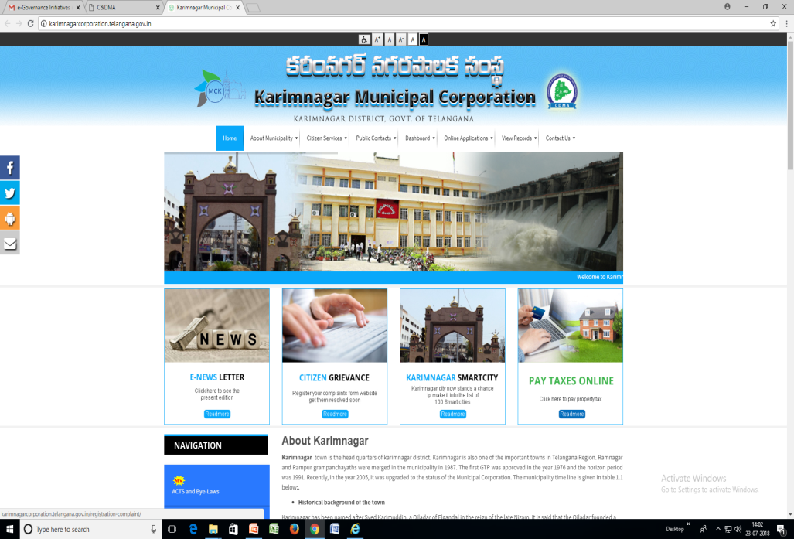
Services through WEB
Citizen can avail services at single platform i.e. in HOD Website or ULB website
HOD web site ULB website
16

Slide 17
Coverage - Services
Assessment of
Property Tax
Vacant Land Tax
Services
Birth & Death Certificates
Correction of Birth Certificates
Assessment of
Trade License
Renewal of Trade License
Advertisement License
Water Supply connection
Mutation
Building Permission
Road Cutting Permission
Payment
Property Tax
Vacant Land Tax
Water Charges

Slide 18
Citizen Monitoring Services

Slide 19
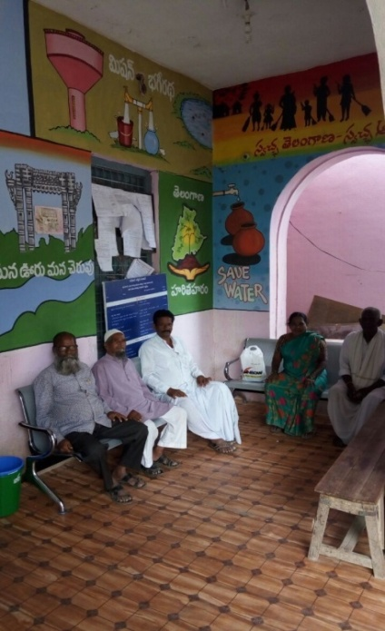
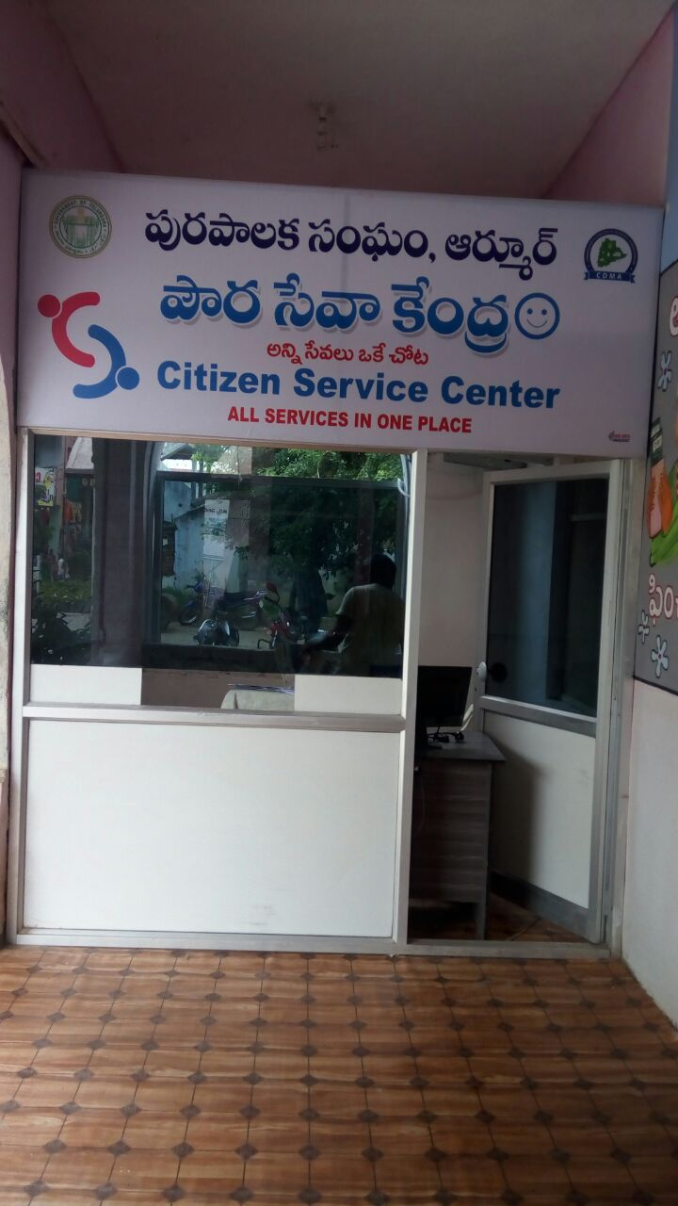
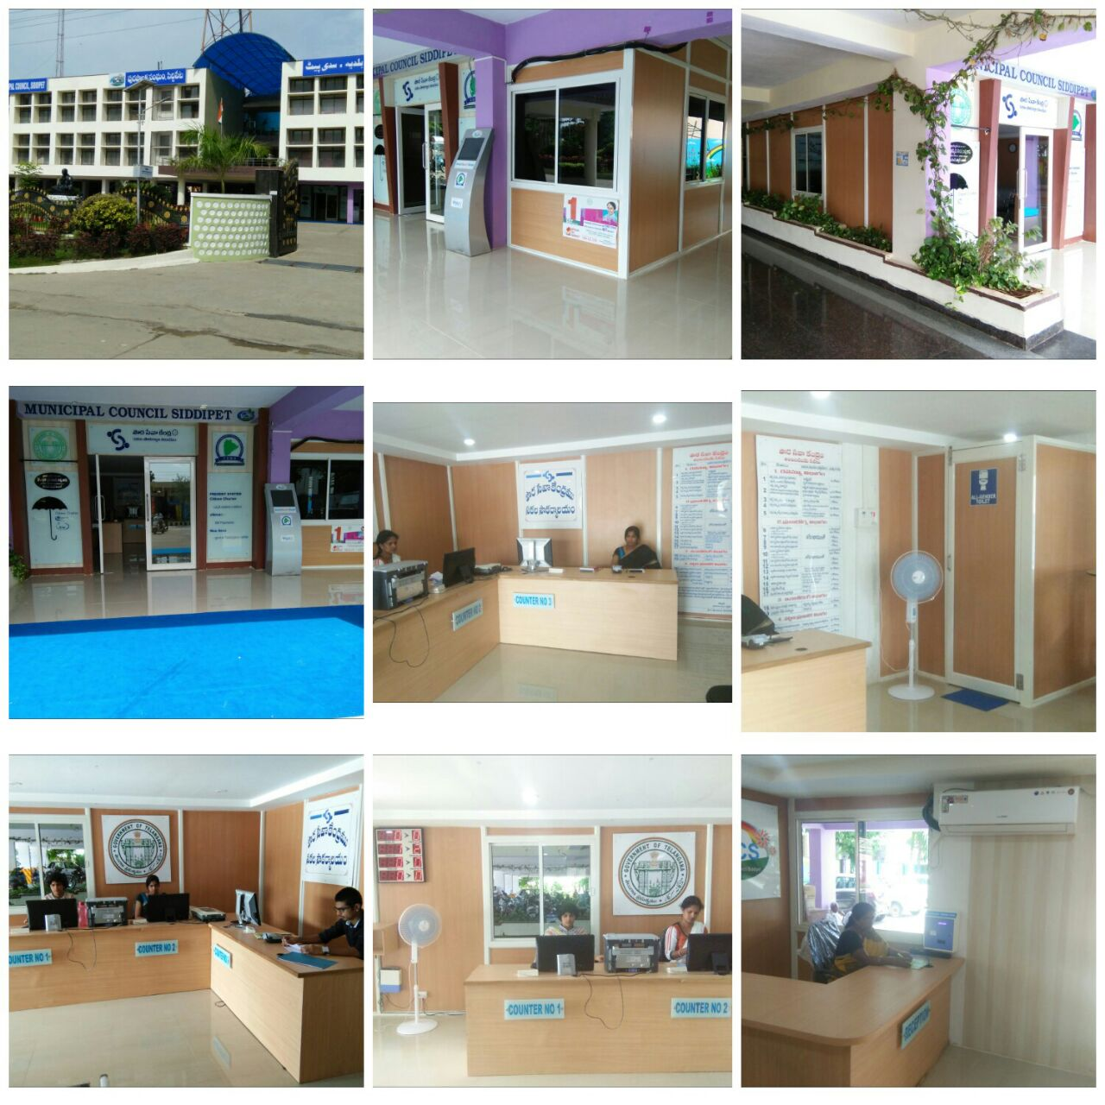
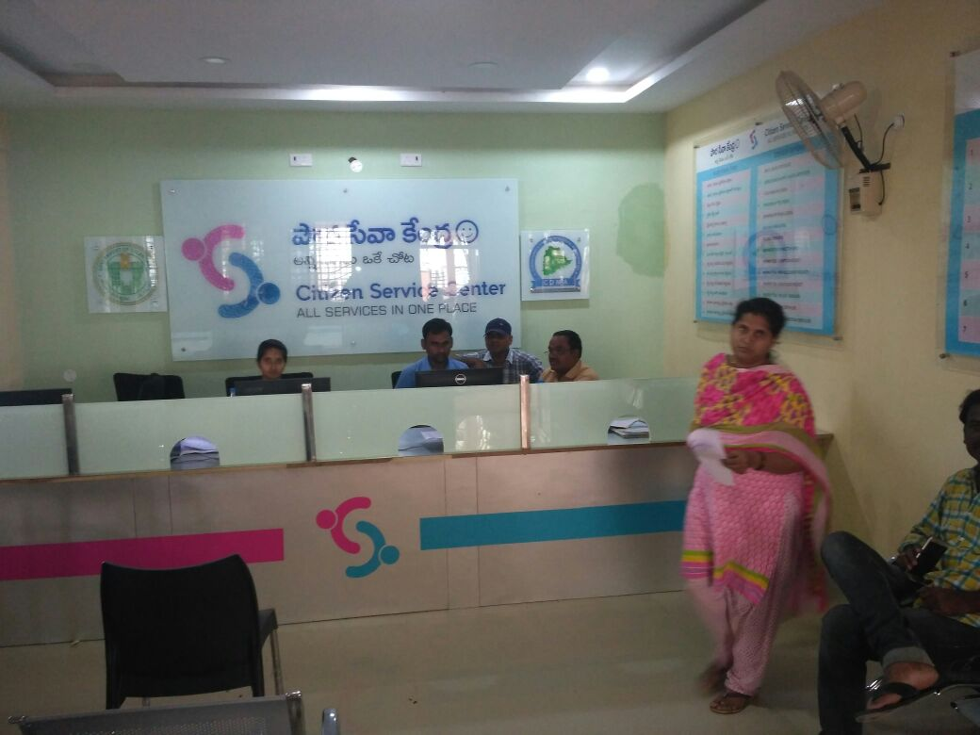
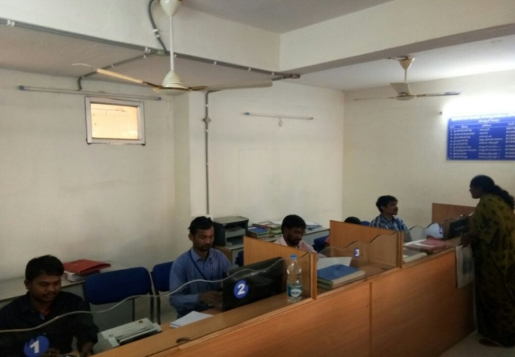
Citizen Services Centres

Slide 20
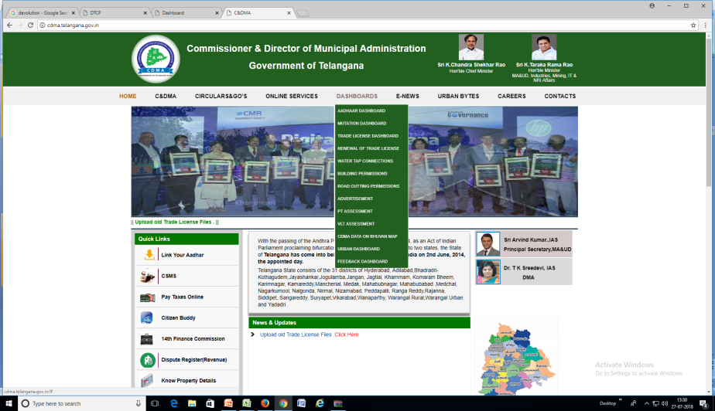
M&E : Dashboard
http://dpms.dtcp.telangana.gov.in/AutoDCR.Dashboard/cdma/dashboard.aspx
www.cdma.telangana.gov.in
Vertical escalation provided in respect of services / grievances.

Slide 21
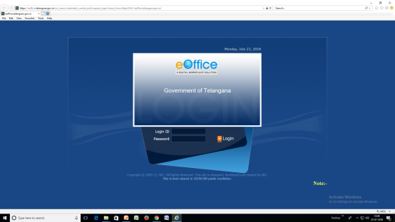
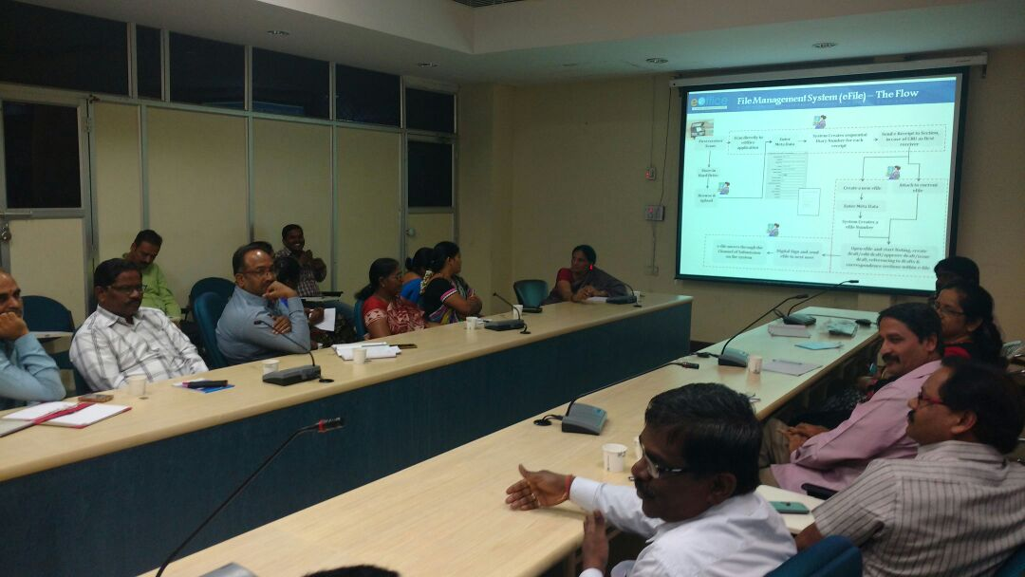
E-office
Features of E-office
Order of file receipt
Priority
Status of total number of pending files
Status of total number of cleared files date wise
24X7 movement
Status of actual number of pending
25,261 no. of files have been generated through e-office till now.
Over one lakh file movement took place.
Outcomes
Accountability & Transparency
Save huge quantity of paper
Time bound processing
Quicker disposal of files
Performance analysis
Empowered staff with new edge technology
Easy Tracking
Operative since 2.2.2017 in HOD and all 72 ULBs
21

Slide 22
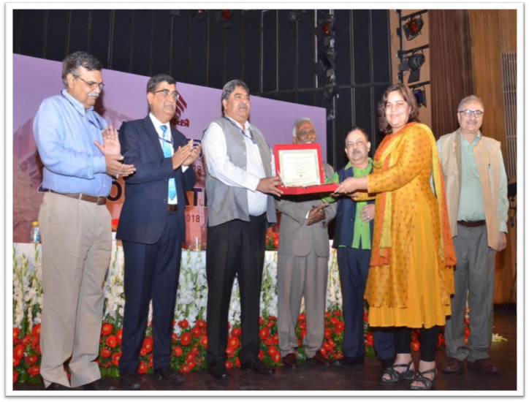
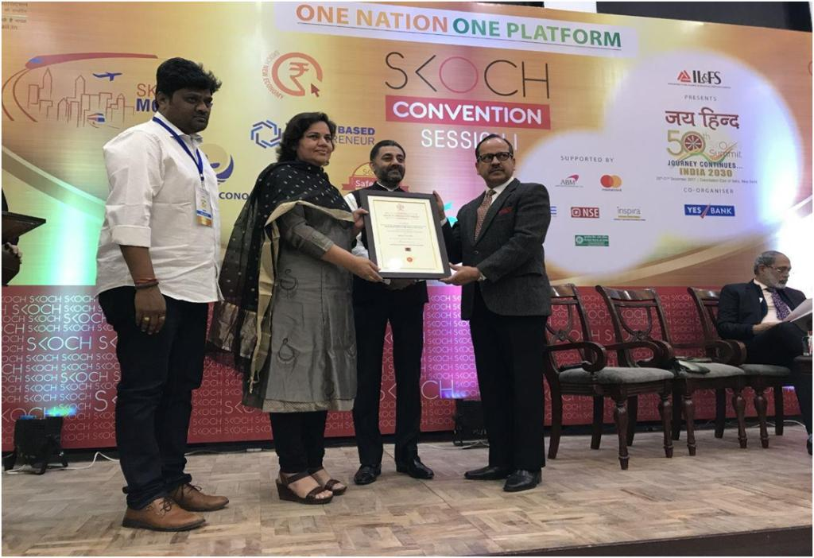
Awards
Property Mapping
Skoch Silver Award –Dec, 2017
Techno Sabha Indian Express Award – Feb, 2018
HUDCO Award (Rs.1 lakh cash prize) – April, 2018
Citizen Service Monitoring System
Skoch Gold Award. – September, 2017
Eoffice
Gem of Telangana Award – Jan, 2018
Skoch Silver Award – June, 2018
LED Street Lights
Skoch Award – June, 2018
Citizen Buddy
Selected for Express Techno Sabha Excellance Award, 2018

Slide 23
Way forward - Egovernance
Government of Telangana is a forerunner in implementing Urban reforms and E- governance initiatives with the objective of improving transparency and service delivery.
Initiated to implement an E-Governance application platform (Information technology and communication suite of application) for providing the department services to the citizens, employees, business, and other departments by way of information sharing.
Current system i.e E-Suvidha, which is used by the department for delivering selective services to citizens, conceptually similar to proposed E-Governance application set but technologically way behind and not suitable to upgrade to current functional requirements.
The e-Governance framework has G2C (Government to Citizen), G2B (Government to Business), G2G (Government to Government) centric services for bringing reform in areas like basic citizen services, revenue earning services, development services, efficiency improvement services, back office improvements and monitoring, etc.
Objectives of the E-Governance Project:
To enhance governance of Urban Local Bodies (ULB) across the State with a collective vision
To improve service delivery mechanism with better quality, effectiveness and accessibility of municipal services
To enhance and augment tax revenues, eliminate redundancies and reduce costs
To provide ‘single window’ municipal services to citizens anywhere, anytime
To improve transparency and accountability across ULB operations, to improve efficiency and productivity of employees
To improve collaboration within ULBs and with other Government Departments, to align e-governance initiatives of MAUD-GoT within the State IT policies and framework.

Slide 24
Thank You
For further queries contact
Commissioner & Director of Municipal Administration
http://cdma.telangana.gov.in/
cdma@cdma.gov.in

