Slide 1
AN INNOVATIVE APPROACH TO CAPACITY BUILDING Case-study of CIDCO’s capacity building programme
Jagan Shah
Director
National Institute of Urban Affairs
New Delhi, India
27th July 2018

Slide 2
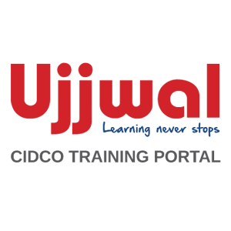
Activities enabling Capacity Building
Comprehensive Training Needs Assessment
Development of training policy
Establishment of a dedicated training cell
Deployment of a customised training management system
Development of knowledge and outreach material
Continuous monitoring calibrated against measurable indicators over a period of time.
2014
2017
Notes:
Working with City and Industrial Development Corporation (CIDCO) in Navi Mumbai, NIUA’s CIDCO Smart City Lab has developed and implemented an innovative capacity building programme for the organisation.

Slide 3
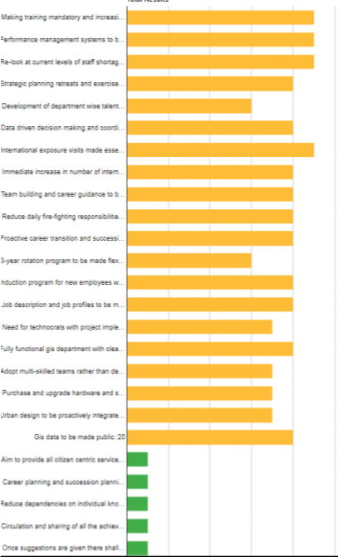
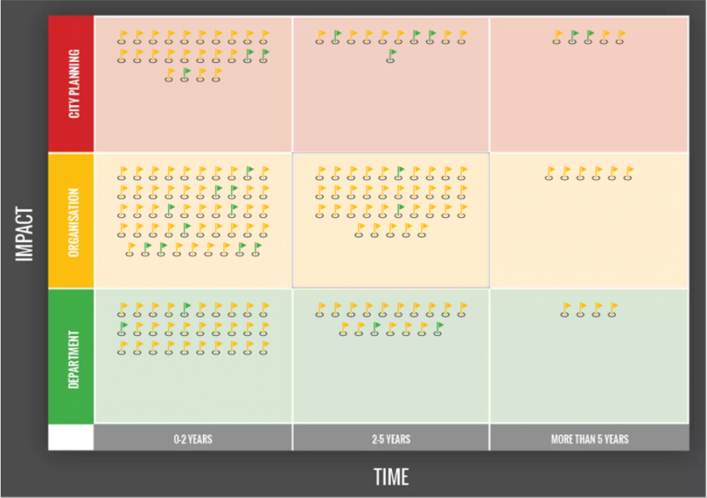
Training Needs Assessment
Notes:
Assessment conducted over 2 months with Heads of Departments and senior managers in 20 departments.
Face-to-Face interviews, online surveys and detailed mapping of:
Nature of skills and tools for everyday functioning
Motivations for job performance
Role of training and capacity building as incentive
Decision making processes for budget and travel approvals
Institutions delivering training for specific skills
Actions Enabling Capacity Building at CIDCO
Recognition of the need to institutionalise capacity building.
Adoption of “Smart Organisation” as an Objective Area (Vertical) in the Smart City Navi Mumbai (South) Action Plan
Establishment of the NIUA-CIDCO Smart City Lab for capacity building and documentation of institutional knowledge
SAP Implementation
Adoption of Institutional reforms such as citizen facilitation centre, online plan approvals, online RTI
Specialised trainings through YASHADA

Slide 4
Implementing CIDCO’s capacity building programme
Creation of a comprehensive employee database
Adoption of training policy
Establishment of training cell
Compilation of list of training institutes
Vetting of the institutes by HODs at CIDCO
Development of online training management system by NIUA’s web unit
Establishment of communication channels with each institute
Creation & vetting of a list of courses offered by the institutes
Testing & deployment of the training management system by the training cell
Handholding & troubleshooting sessions by the training cell in each department
Continued refinement of the training management system to CIDCO’s requirements….
Notes:
Implementing Capacity Building Programme at CIDCO:
Adoption of training policy

Slide 5
Guiding Principles
Minimize barriers such as number of approvals, lack of information about institutes, courses and payment terms, travel and accommodation budgets etc.
Allow feedback and sharing of good and bad experiences about the courses
Incorporate all stages of learning – learning to learn, learning to do and learning to evolve.
Recognize different motivating factors for training and incorporating it into performance management
Intensification of staff development
Minimum 5 days per year and maximum 15 days in three years
3 typologies and induction training
Step up performance based framework
6 month cooling-off period between two trainings
Facilitation of Training
Local training cell and online training management system
No approvals needed
All costs borne by CIDCO: Rs 11 crore allocated per annum
Courses mapped for 5 cadres and 2 classes
Transparent eligibility criteria developed and communicated to all employees
Feedback and sharing
Feedback by participants to refine the training programs
Sharing of training material and experiences with peers within the organization
Highlights of CIDCO’s training policy
Guiding principles of CIDCO’s training policy
1. Minimize barriers
2. Allow feedback and sharing
3. Incorporate all stages of learning
4. Recognize different motivating factors
5. Institutionalize a recurrent commitment

Slide 6
Implementing CIDCO’s capacity building programme
Creation of a comprehensive employee database
Adoption of training policy
Establishment of training cell
Compilation of list of training institutes
Vetting of the institutes by HODs at CIDCO
Development of online training management system by NIUA’s web unit
Establishment of communication channels with each institute
Creation & vetting of a list of courses offered by the institutes
Testing & deployment of the training management system by the training cell
Handholding & troubleshooting sessions by the training cell in each department
Continued refinement of the training management system to CIDCO’s requirements….

Slide 7
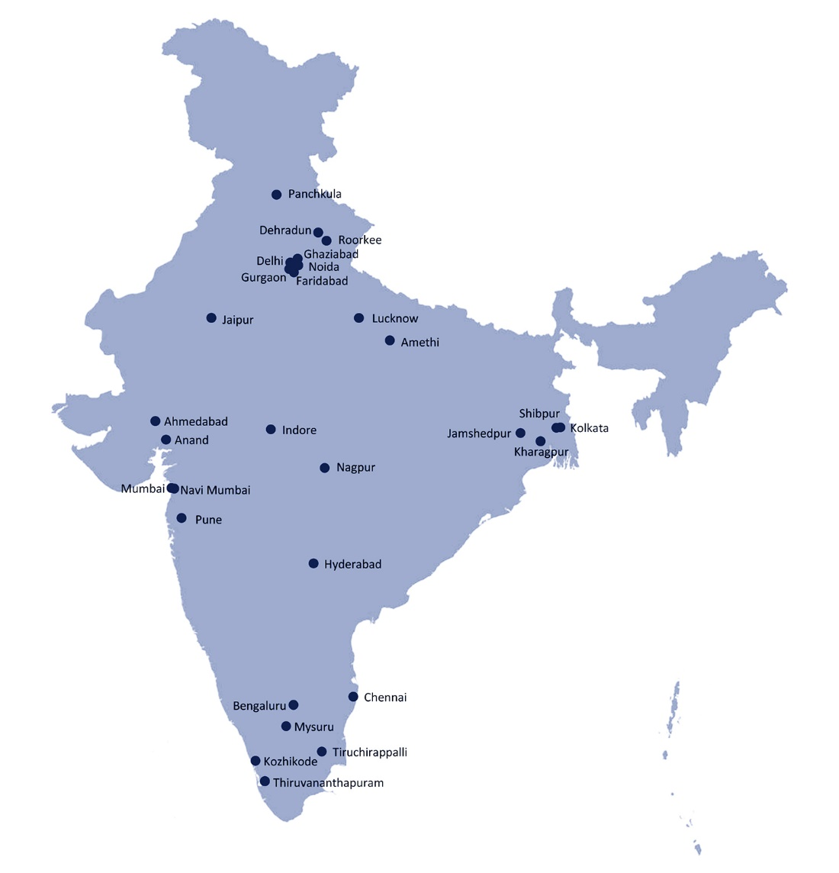
Local Training Cell and Training Network
Responsibilities of the training cell
Map course offerings to employee and organizational needs
Resolve:
Queries related to course objectives
Issues related to work-training balance
Financial queries received
Embrace the training policy and commitment to training
Collate employee data and update employee information
Develop customized and induction training using internal organizational resources
85 institutes, 30 cities
and growing..
637 courses
and growing..
Notes:
Map course offerings to employee and organizational needs.
Resolve:
Queries related to course objectives
Issues related to work-training balance, lacking which results in denial/unwillingness for training
Financial Queries received from teams of Accounts / Audit / Institutes.
Embrace the training policy and commitment to training.
Convince employees and heads of departments on the need for training
Break down the defined course objective for the employees to well understand the course details.
Collate employee data and update employee information
Develop customized and induction training using internal organizational resources
Training network - Compilation of list of training institutes from across the country (from NIUA & CIDCO’s network) has around -- courses across 86 institutes and 30 cities

Slide 8
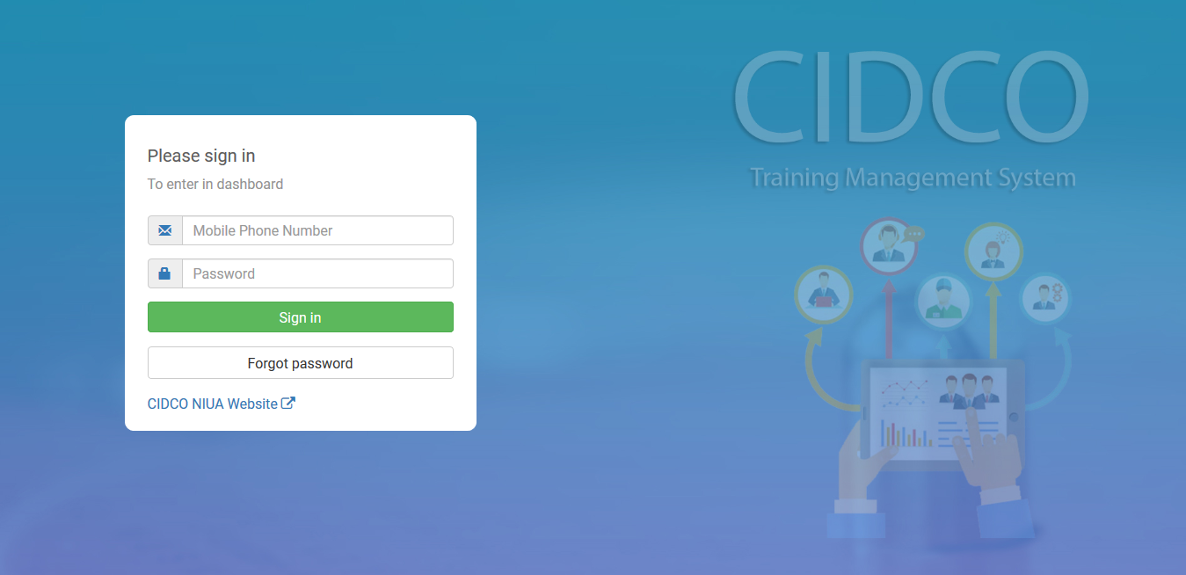
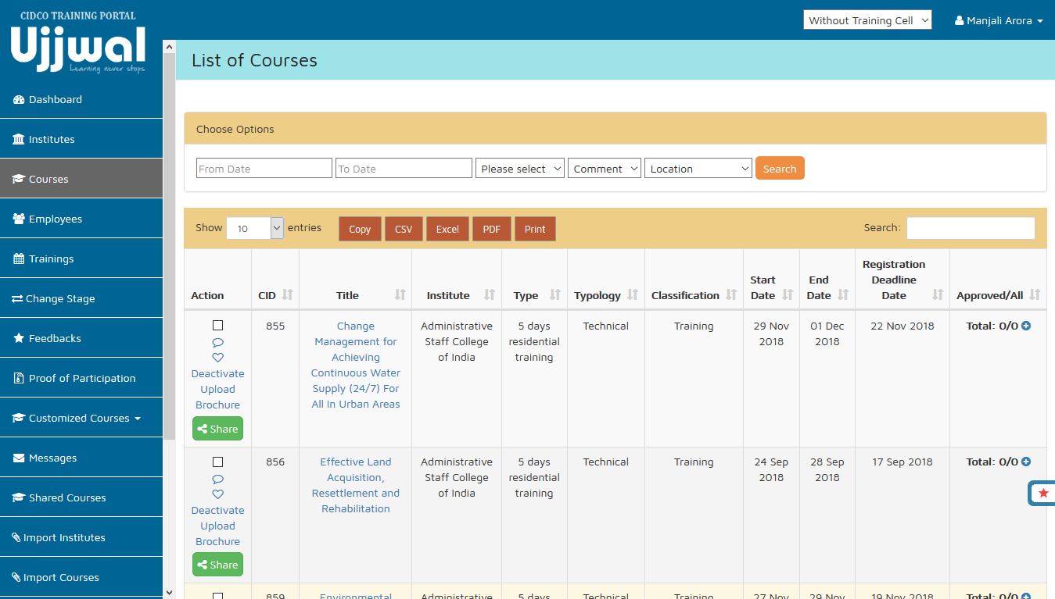
Training Management System - UJJWAL
UJJWAL: NIUA-CIDCO’s One Stop Shop for Training Management for the Organization
Employee management
Import of employee profiles from SAP
Manager, peer and Head of Department relationships
Role and responsibilities in the Organization
Courses management
External interface to the training institutes
Annual calendar
Course details with location, fees, brochure, etc.
Keyword and location search
https://cidco-smartcity.niua.org/ujjwal/login.php
Notes:
The cycle of the training management system is based on these 4 pointers:
Employee management
Direct import of employee profiles from SAP system
Manager, Peer and Head of Department Relationships
Role and Responsibilities in the Organization
Courses management
External Interface to the Training Institutes Annual Calendar
Course Details with location, fees, brochure, registration requirement
Keyword and Location Search

Slide 9
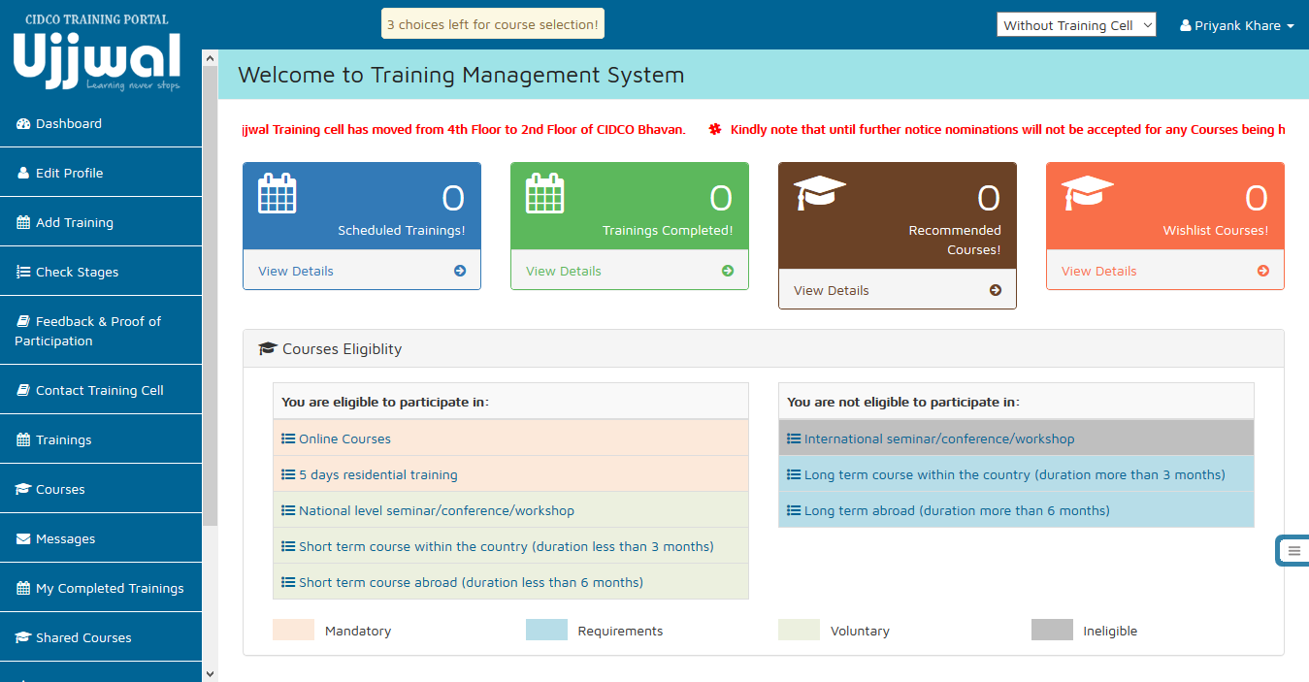
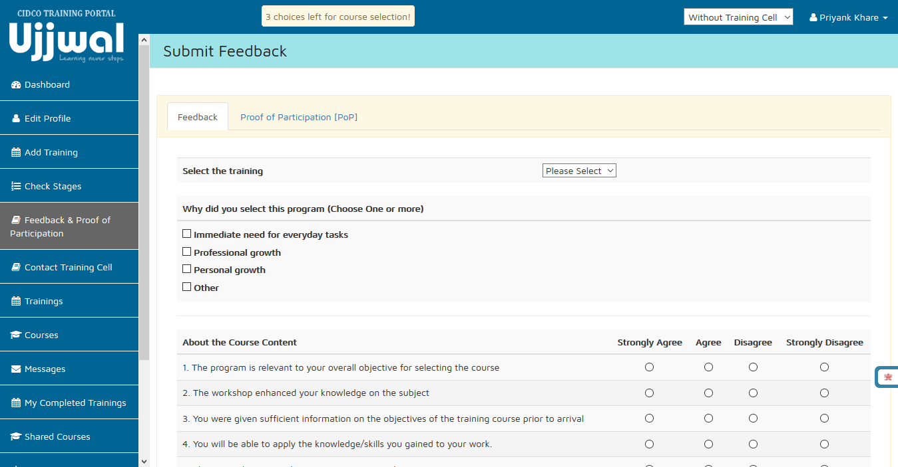
Training Management System - UJJWAL
Training management
Eligibility criteria based on CIDCO’s training policy
Prioritize courses
Customized trainings
Manage stages of training
Payment through SAP
Feedback and Outreach
Rating of courses based on 16 criteria
Sharing of courses with peers and supervisors
Monthly, quarterly and annual reports to managers and supervisors
Notes:
The cycle of the training management system is based on these 4 pointers:
Training management
Eligibility Criteria based on organization training policy
Prioritize Courses
Customized Trainings
Manage Stages of Training – Registration, Confirmation, Travel Arrangement, Course Participation, Payment and Feedback
Payment automatically integrated
Feedback And Outreach
Rating of Courses based on 16 criteria
Sharing of Courses with peers and supervisors
Monthly, quarterly and annual reports to managers and supervisors
In the upcoming stages, we plan on posting the certification on LinkedIn in case of certificate courses

Slide 10
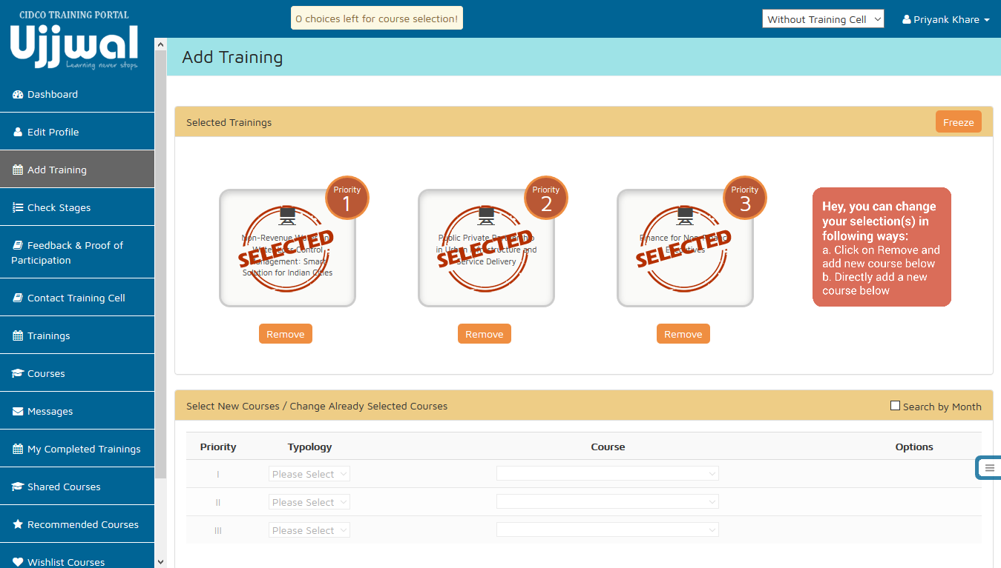
Check for available dates and the course details
Log-in and visit the dashboard
Select the typology and pick a course of your choice
Once sure, you can freeze them to register interest.
Select 3 courses based on your choices and priorities
Applying for a training
Approval confirms enrollment.
The request is forwarded to the training cell.
The choices are reviewed by the training cell and approved or rejected.
Travel and accommodation is arranged. The payment is made to the institute.
Confirmation of participation at the end of the training
Submit feedback and proof of participation
Completion of training
Customised training request
Sharing of courses with peers and colleagues
Contact training cell
https://cidco-smartcity.niua.org/training-through-ujjwal/

Slide 11
Comparing the courses
Usual Training modules:
Resource Mobilisation
Municipal Accounting Reforms
Project and Contract Management
Integrated Land Use
Transport Planning
Transit Oriented Development
Sewerage and Septage management
Storm water drainage
Supervisory Control and Data Acquisition (SCADA)
Geographic Information Systems (GIS)
Project Development and Management
Sample of supplementary courses under CIDCO’s training management system:
Managing work stress for superior performance
Personality development workshop for managers.
Individual excellence for organizational effectiveness
Leadership through self-discovery
Developing your teams for superior performance
Internet of Things (IoT): What every manager needs to know about IoT
Managing gender diversity for improved organizational performance: Legal and managerial perspective
The art of successful leadership and management
Senior leadership coaching: Coaching for performance
Stress management
Housing for all: Attaining the national Agenda
Towards zero waste: Decentralized Solid Waste Management
SDGs and climate change: Opportunities and challenges of adaptation and mitigation
Strategising CSR, Sustainable Development Goals: Projects design, Implementation monitoring, Reporting and Way forward action
Principles and practices of climate adaptation: Livable smart cities
Excellence in Managerial communication
AND MANY MORE…
Notes:
The courses concentrates on the individual growth of the employees and looks into the managerial and behavioural aspects too. The courses are tailor-made according to the demands of the employees and the organization.

Slide 12
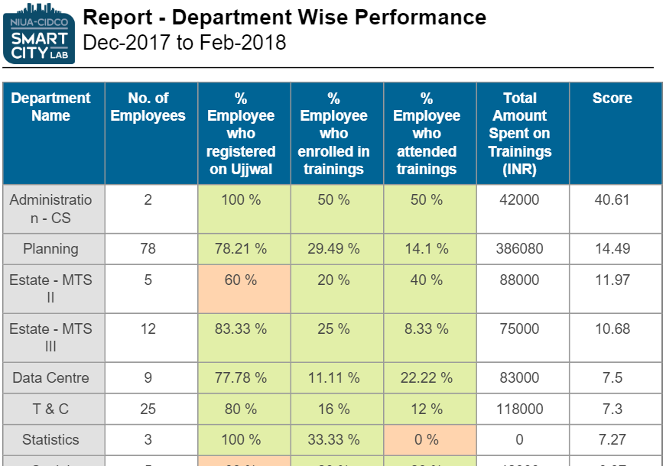
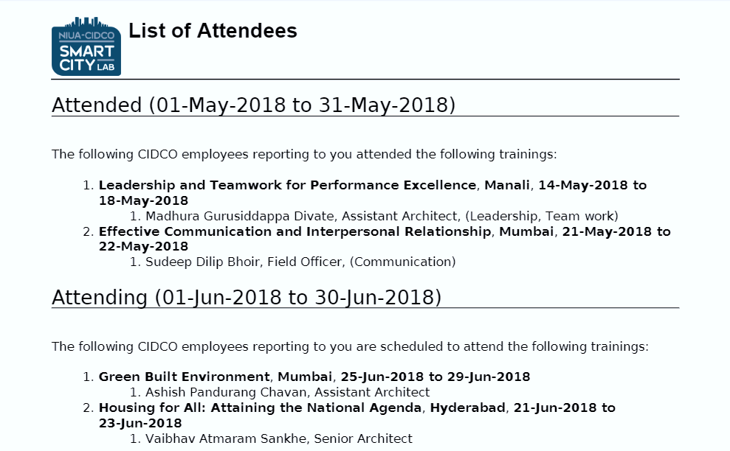
Monthly and quarterly reports
The reports sent:
The comparative department wise performance reports for the upper management
List of attendees for work and skill management for HODs and reporting officers.

Slide 13
Numbers so far – Institutes and Courses
637 courses mapped
Employees have expressed interest in 327 courses.
300 employees have participated in at least one course.
Average cost of trainings – Rs. 45,000
79% courses have a fees of less than Rs. 50,000.
Average money spent (inc. travel) on trainings – Rs. 75,000.
380
231
48%
Most attended institutes – ASCI, Hyderabad; IIM, Ahmedabad; ESCI, Hyderabad and National Productivity Council, New Delhi
5 customised trainings with 88 participants on topics:
Legal training
Training for newly appointed surveyors
Outbound Training for Personnel on HR processes and Labor Laws
53%
26
77%
As on 15th June, 2018

Slide 14
Numbers so far - Employees
Total number of class I and class II CIDCO employees - 832
Total number of employees logged-in - 599
Out of the total number of class I and class II employees, 70% males and 78% females have registered on the portal.
Out of the total log-ins, 46% males and 63% females have attended at least one training.
653
460
212
179
139
88
As on 15th June, 2018

Slide 15
Summary of Salient Features
Comprehensive
Different typologies of courses, National and international, variety of courses to choose from.
Customised
Dedicated handholding sessions, specialised customised courses.
Competence-based
For employees from 5 different cadres and 2 classes
Timely
3 Days to process approval instead of 2 to 3 weeks in case of manual processing
Readiness-based
Committed financial resources, training policy
Peer-connected
Sharing the courses, wish-listing, SMS and e-mail alerts, monthly and quarterly reports
Assessment-based
Training Needs Assessment, 16 parameters feedback
Contextualised
Trainings geared towards CIDCO’s overall goal of ‘building cities’
Mobile Application
SMS and app based interactions
Notes:
Comprehensive
• Different typologies of courses: Behavioral, Managerial, Technical, Induction Courses
• National and International - Online Courses, Residential Courses, Conference/Seminar/Workshop
• Variety of course durations to choose from: 1 Day, 2 Days , 3 Days, 4 Days, 5 Days & 6 Days
• All courses vetted by six different department heads (representing 90% of CIDCO employees)
Customised
• Dedicated handholding sessions for using the training management system for all employees (conducted for over 19 departments already)
• Special Customised trainings (77 Employee Trained – Legal, Survey, MS Office)
Competence-Based
• Courses available for employees from 5 different cadres and 2 classes
Timely
• Every month has a selection of over 25 courses
• 3 Days to process approval through the online training management system instead of 2 to 3 weeks in case of manual processing
• Five stages of approval reduced to one as a result of training policy adoption and online application process
• Over 85 institutes in our growing network including: IIHS, CEPT, IIT Powai, IIM Ahmedabad, IIM Bangalore, ASCI, ESCI, CSE, IFMR, ISB, NEERI
Peer-Connected
• Employee can share courses with all CIDCO Employee (over 800) within the training system
• Facility to wish-list shared courses for participation in future
• Dedicated messaging system with SMS & Email alerts
• Monthly & quarterly reports from the training management system listing skills gained by participating employees
Readiness-Based
• Committed financial resources towards training its employees: travel and participation fees – INR 75,000 per employee
• Travel policy to ensure easy access to the trainings for employees
Assessment-Based
• Employee submits feedback on 16 parameters reviewing the content and delivery methods of the training immediately upon completion
• Training Needs assessment conducted for all 20 departments before training policy formulation
Contextualised
• Trainings geared towards CIDCO’s overall goal of ‘building cities’
• 65% (13) of departments (20) have already participated in training in first 6 months

Slide 16
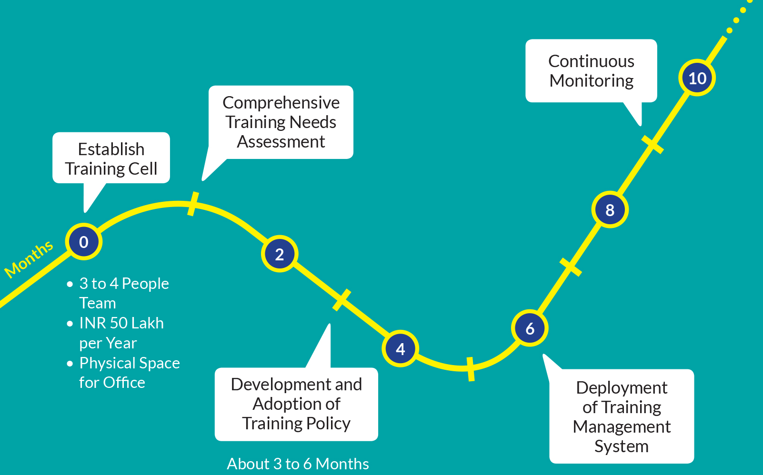
Resource Requirements
Planned enhancements
Smart Phone Application
Knowledge Repository
Integration with Performance Management System

Slide 17
Feedback
“Great experience. I thank everyone who is a part of this policy and implementation of capacity enhancement program.”
“Course subject and the lectures were very relevant to what CIDCO do i.e. plan and develop infrastructure.”
“The course was helpful because a significant portion of engineering projects require us to deal with the legal matters.”
“It is a necessity to develop and update ourselves by attending training programmes, conferences, seminars, etc… being made possible because of Ujjwal Training Portal, which has many training programmes all over India, where we can select options as per our requirements.”
“The overall experience was good because of this training we had a chance to introduction with updated softwares.”
“Simulation exercise on Arbitration was outstanding.”
“…Great presentation style with lots of opportunities to ask questions and talk about real life examples…”
“It is necessary to update our knowledge and maintain pace with the world. Such programmes help us to achieve this goal.”

Slide 18
Questions/Suggestions
If you are interested in learning more about NIUA’s training management program, contact us at:
National Institute of Urban Affairs Core 4B, First Floor, India Habitat Centre, Lodhi Road, New Delhi – 110003, India
Contact: +91-11-24643576; director@niua.org

