Slide 1
Pilot on FORMULATION Local Area Plan & Town Planning Scheme: Salient Features.
City
Renewal
City
Improvement
City
Expansion
Town & Country Planning Organisation
Ministry of Housing and Urban Affairs
Government of India
28th July,2018

Slide 2
BACKGROUND OF THE NEW SCHEME-LAP& TPS
In the backdrop of rapid urbanization two key challenges are have emerged:
Existing settlements formed over years through incremental growth/accretion contain areas in city core that may require redevelopment.
Physical expansion on periphery leading to haphazard growth, substandard urban services.
Existing areas/city core can be redeveloped by preparing Local Area based Plans (LAPs).
Town Planning Schemes (TPS) can be implemented for planned urban expansion in the peripheral greenfield areas.

Slide 3
BACKGROUND
Master Plan of City
AMRUT:
GIS based Master Plan
Pilot Scheme:
LAP & TPS
Redevelopment Areas: Local Area Plans
New Urban areas: Town Planning Scheme
Built up City Area
Redevelopment Areas
Expansion Areas
Master Plan Area

Slide 4
OBJECTIVES OF THE PILOT SCHEME
Establishing a framework for redevelopment of existing areas through the development of LAPs
Enabling planned expansion in peri-urban areas through UEP
Supporting Value Capture techniques to finance infrastructure investments.
Creating enabling legal framework where required.
Building capacity through training and certification of planners at city and state level to ensure proper implementation of the above strategies.
Demonstrate applicability of Local Area Plan (LAP) and Town Planning Scheme (TPS) as efficient planning tools – eventually encourage replication across cities/states

Slide 5
COVERAGE :CITIES IDENTIFIED
25 smart cities in 25 states taken as pilot cities
Synergies with the Smart Cities Mission with respect to component on Redevelopment and Area Based Strategy
All 25 cities are covered under Smart cities Mission
Scheme is on pilot basis and depending on State Government response, more cities may be covered in future.

Slide 6
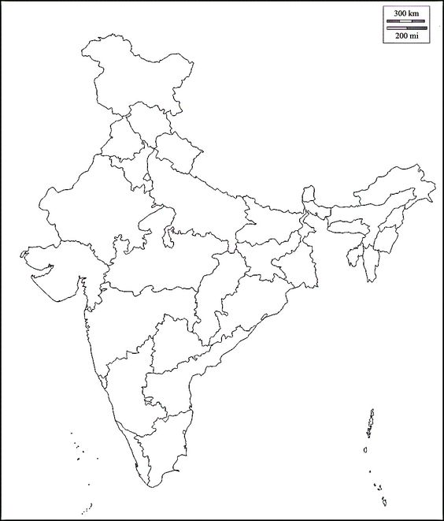
COVERAGE :CITIES IDENTIFIED
Sl. No | City | State | Population Census 2011 | Whether Master Plan Available/Notified
1 | Greater Visakhapatnam | Andhra Pradesh | 6,47,508 | Yes
2 | Guwahati | Assam | 9,57,352 | Yes
3 | Vadodara | Gujarat | 16,70,806 | Yes
4 | Indore | Madhya Pradesh | 19,64,086 | Yes
5 | Chennai | Tamil Nadu | 46,46,732 | Yes
6 | Bengaluru | Karnataka | 84,43,675 | Yes
7 | Thiruvananthapuram | Kerala | 7,43,691 | Yes
8 | Warangal | Telangana | 6,15,998 | Yes
9 | Pune | Maharashtra | 31,24,458 | Yes
10 | Varanasi | Uttar Pradesh | 11,98,491 | Yes
11 | Jaipur | Rajasthan | 30,46,163 | Yes
12 | Amritsar | Punjab | 11,32,383 | Yes
13 | Patna | Bihar | 16,84,222 | Yes
14 | Faridabad | Haryana | 8,76,969 | Yes
15 | Bhubaneswar | Odisha | 8,40,834 | Yes
16 | Ranchi | Jharkhand | 10,73,427 | Yes
17 | Raipur | Chhattisgarh | 10,10,433 | Yes
18 | Panaji | Goa | 1,14,405 | Yes
19 | Shimla | Himachal Pradesh | 1,69,578 | Yes
20 | New Kolkata | West Bengal | 1,85,060 | Yes
21 | Srinagar | Jammu and Kashmir | 12,06,419 | Yes
22 | Dehradun | Uttarakhand | 5,69,578 | Yes
23 | Aizawl | Mizoram | 2,91,822 | Yes
24 | Gangtok | Sikkim | 1,00,286 | Yes
25 | Imphal | Manipur | 2,68,243 | Yes
Srinagar
Shimla
Amritsar
Dehradun
Gangtok
Faridabad
Guwahati
Jaipur
Varanasi
Patna
Imphal
Vadodra
Indore
Ranchi
Aizawl
Raipur
New Kolkata
Bhubaneshwar
Pune
Warangal
Gr. Vishakhapatnam
Panaji
Bengaluru
Chennai
Thiruvananthpuram

Slide 7
FUNDING
Stakeholders’ consultation to be conducted by UDA/ULB to prioritize requirements and facilitate implementation
Review of statutory framework in the state to assess for preparation and implementation of RP and EP
Nodal Agency shall be identified by the state for coordination at state level
Capacity Building of personnel from the UDA/ULB for preparation and implementation of RP and EP
Cost calculation only includes technical component, no physical/development work
The central assistance for the Scheme would be 100% and shall be released in 3 Installment
On an average, a city is likely to get about Rs 2 Crores
Installment | Percentage of total funds | Stage of releases (3 Installments)
I | 20% | On the identification of cities and submission of preliminary proposal
II | 40% | Submission of Draft Plan
III | 40% | Submission of Final Plan

Slide 8
TIME PERIOD AND DELIVERABLES
The pilot is spread over a period of three years. The cities will submit proposals as and when they have completed the training programme:
Preliminary proposal - 2 months
Draft Plan - 10 months
Final Plan - 12 months (One year)
CEPT University has already conducted for Capacity Building Programme in LAP and TPS for the Town Planners working in T&CPDs,UDAs and ULBs.

Slide 9
METHODOLOGY FOR LOCAL AREA PLAN(LAP)
Sl No | Stage / Activities | Total duration
A | Preliminary Stage | 2 Months
1 | Delineation of the project area
2 | Preliminary Gazette Notification
3 | Stakeholdes’ Consultation
B | Draft Stage | 10 months
1 | Detailed area survey (Scale 1:250/1:500)
2 | Compiling list of land owners
3 | Infrastructure assessment, projections
4 | Merger of original plots and preparation of final plots (Scale 1:250 / 1:500) Emerging provisions of TDR, Area Based FSI, New and renewable energy, Environment conservation for urban lakes, Disaster management, Rain water harvesting etc. be used
5 | Stakeholders’ consultation
C | Final proposal | 1 Year
1 | Submitting proposal in government for approval
2 | Gazette Notification

Slide 10
METHODOLOGY FOR TOWN PLANNING SCHEME (TPS)
Sl No | Stage / Activities | Total duration
A | Preliminary Stage | 2 Months
1 | Delineation of the project area
2 | Preliminary Gazette Notification
3 | Stakeholdes’ Consultation
B | Draft Stage | 10 Months
1 | Detailed area survey (Scale 1:250/1:500)
2 | Compiling list of land owners
3 | Infrastructure assessment, projections
4 | Merger of original plots and preparation of final plots (Scale 1:250 / 1:500) Emerging provisions of TDR, Area Based FSI, New and renewable energy, Environment conservation for urban lakes, Disaster management, Rain water harvesting etc. be used
5 | Stakeholders’ consultation
C | Final proposal | 1 Year
1 | Submitting proposal in government for approval
2 | Gazette Notification

Slide 11
Training and Certification
1-Day Sensitization Programmes – For political representatives and key decision makers at State/City level
3-Day Basic Programmes – For planners, engineers and other technical staff likely to be involved with implementation of the pilot
3-Day Advanced Programmes – For technical officers who have undergone Basic training, where advanced concepts such as uses of software and GIS, use of VCF tools etc. would be covered

Slide 12
Roles and Responsibilities
Entity | Responsibilities
State UDD/ ULB/ UDA | Plan preparation Innovative source of finance (VCF, TDR etc) Ensuring timely completion
MoHUA / TCPO | Provision of funds Monitoring progress Coordination and facilitation of peer learning Support external institution for training and capacity building Knowledge bank

Slide 13
Review and Monitoring
National Level
An Apex Committee of AMRUT Mission, chaired by the Secretary, (MoHUA) and comprising representatives of related Ministries and organizations will supervise the pilot
State level
State Level High Powered Steering Committee (SHPSC) set up under the AMRUT Mission, chaired by the State Chief Secretary, shall steer the pilot
National Level Technical Review and Monitoring Committee
Shall be set up at TCPO for providing technical assistance to Apex Committee and SHPSC
TCPO will examine and submit its recommendations to the Apex Committee for the release of installments

Slide 14
Way Forward
Ministry shall shortly write to all 25 states requesting them to send the preliminary proposal for LAP/TPS.
The Anchor Institute, as a part of capacity building, shall sensitise the officials of municipal corporation/UDAs to submit the proposals to ministry through SHPC for consideration of Apex committee under AMRUT.
Based on the examination of proposals by TCPO, the first installment will be released.

Slide 15
Thank you

