Slide 1
Online Building Permission System Vivek Aggarwal Principal Secretary Urban Development & Housing Department Govt. of Madhya Pradesh

Slide 2
Initially OBPS Implemented in 14 Municipal Corporations.
From 1st April 2018 – OBPS Implemented in all remaining Urban Local Bodies of Madhya Pradesh
End to End Operations Online
Application, Scrutiny, Online Fee Memo Generation, Payment, Final Approval with digital signatures

Slide 3
All Colony data digitized
Scrutiny as per Master Plan, Town & Country Planning Layout and Bhoomi Vikas Niyam
Site Visit is captured through mobile app only
All Towns integrated with Command Control Centre at Bhopal

Slide 4
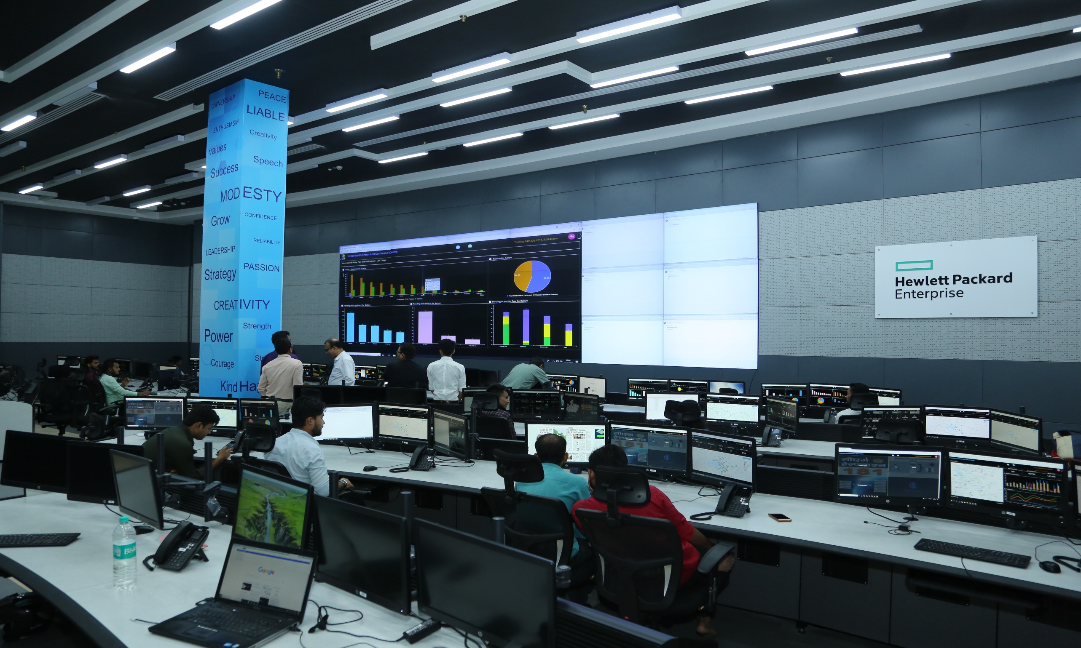

Slide 5
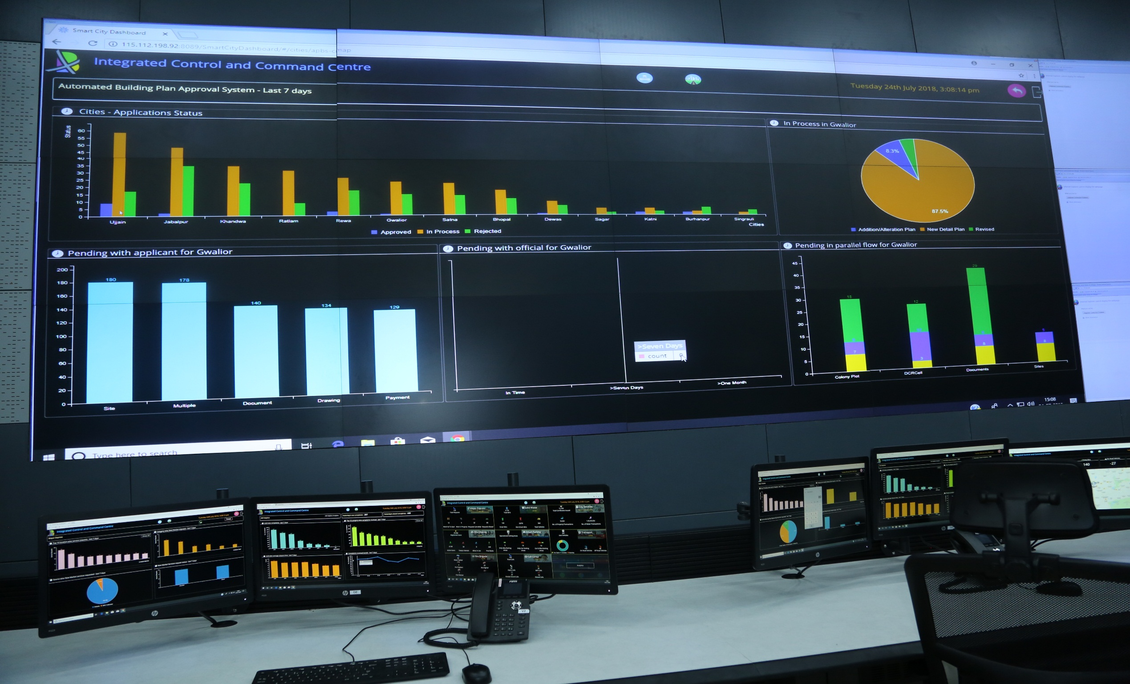

Slide 6
Core Team based at Bhopal
Team of 3 members in every Municipal Corporation
Team of 12 Members in every Divisional headquarter
Continuous Capacity Building
More than 3000 Architects registered

Slide 7
Post Sanction – Work Commencement Intimation, Plinth Level Inspection, Service Certificate, Completion cum Occupancy Certificate issued online
Alert to applicants/officials through SMS/mail at all stages
All permissions available in Public Domain
Architects authorized to issue permission on plot size upto 300 sqmtr.

Slide 8
4509 Model drawings uploaded, can be selected based on Plot Size, FAR, Road Width etc.
Citizen can select model drawings and make online payment. That receipt itself becomes the permission.
Integration with external agencies.
More than 85000 cases sanctioned across the State

Slide 9
.….Thank You…..

