Slide 1
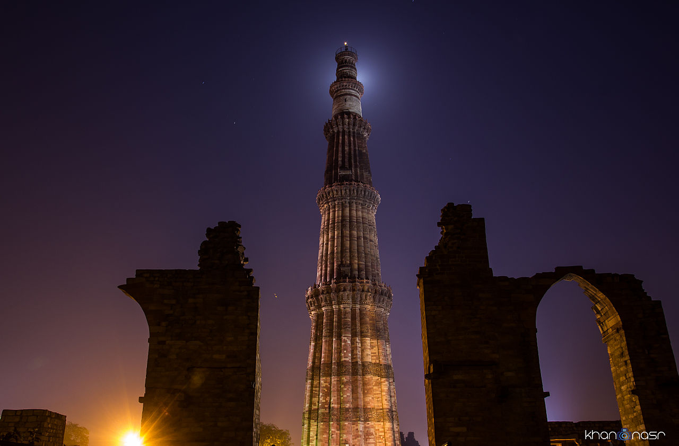

ONLINE BUILDING PERMISSION SYSTEM:
South Delhi Municipal Corporation
July 28, 2018

Slide 2
Reforms under Single Window Clearance System
Entire Building permit / completion process (Building Plan Approval, Plinth Approval & Completion cum Occupancy Certificate) reduced to 8 procedures and all permits are granted in less than 60 days
Common Application Form (CAF), integrating all external/internal agencies
Online Calculator for fee calculation and online payment have been integrated with the Single Window System
Integrated CCZM for all agencies on GIS based color coded map (for ascertaining requirement of NOCs by location)

Slide 3
Reforms under Single Window Clearance System (SWCS)
Risk-Based Classification of buildings to fast track approval for low risk buildings
Requirement of affidavits done away with: replaced by a single e-undertaking
Requirement of No Tax Dues certificate has been done away with
Building permits / Completion Certificates issued online with digital signature: No personal visit required

Slide 4
Reforms under Single Window Clearance System (SWCS)
COCCRF (Common Occupancy cum completion Request Form): Single application for inspection and NOC certification
Road Cutting and restoration charges for water and sewer connections are collected only for a length up to 5 mts
Joint Inspection by all relevant external agencies and in house departments to issue NOCs for OCC
Provision to submit site photographs, thereby eliminating the requirement of on-site inspection for Low Risk Buildings.

Slide 5
Reforms under Single Window Clearance System (SWCS)
Decennial Latent defect liability and professional indemnity insurance have been introduced in the UBBL-2016 (Amendment)
Number of documents for building permit has been reduced from 39 to 7
SARAL Scheme : upto a plot size of 105 sq mts intimation by the Architect is acknowledged without any physical visit.

Slide 6
Transformed Ease: “Then” and “Now” scenarios w.r.t April 2016 (OPBAS Go-live)
S. No. | Procedures | THEN (Before 08-04-2016) | NOW (31-03-2018)
1 | Mode of Submission | Hard file | Online
2 | No. of Procedures | 24 | 8
3 | Timeline (From sanction to completion) | 157.5 days | { Sanction - 30 } 60 days { Plinth - 07 } { CC - 22 }
4 | No. of documents | 39 | 7
5 | NOC s | 11 Depts. (Individual NOC from each Deptt.) | 9 NOC Deptts. Integrated Time Limit - 15 days, else Deemed Approval - On 16th Day
6 | Approval process | Manual | Online
7 | Payment | Offline/Demand Draft/Cash | Online payment through Debit/Credit Card, RTGS, NEFT and net banking
Further

Slide 7
Transformed Ease: “Then” and “Now” scenario w.r.t April 2016
8 | Fee Calculator | Manual | Automatic online fee calculator
9 | Release of Plans | Hard/manually signed | Online/Digitally Signed
10 | Deemed Sanction- Plans | No Deemed approval | Deemed Approval – On 31st day
11 | Know your NOC through CCZM | Hard copy from all Deptts. i.e. AAI/DUAC /DMRC/NMA | In GIS map of GSDL, NOC requirements can be ascertained online
12 | Affidavits & Indemnity Bonds for basement | 16 notarized affidavits | Only single e-undertaking
13 | Inspections for Sanction/Plinth | Inspection by MCD | For sanction – No inspection by MCD For C1/C2 : a) very Low/Low Risk–Architect/Engineer b) Moderate & High Risk –Architect& Department
14 | Joint Inspection for Completion Certificate | DFS, DJB and different other NOC agencies on different dates | Single Joint Inspection by all agencies on the date generated by system

Slide 8
Transformed Ease: “Then” and “Now” scenario w.r.t April 2016
S. No. | Procedures | THEN (Before 08-04-2016) | NOW (31-03-2018)
15 | Property Tax Payment Receipt | Last paid receipt was required | No more required in CAF
16 | Details of sanction plans & completion certificates | Manual Enquiry | Available in public domain
17 | Commencement Notice | Was required as per Clause 7.2.1 of Annexure-B of BBL-1983 | Not required in UBBL-2016
18 | Dashboard for public | Manual Enquiry | Dynamic Dashboard in public domain
19 | Application status update | Manual Enquiry | SMS/E-mail alert / Online on Website
20 | Delhi Jal Board (DJB) | Earlier NOC required & time taken for road cutting permission was 1 to 2 month | No NOC required from DJB. Road cutting beyond 5 mtr. to be done by building proponent. Time & cost reduced.
21 | All Circular/Office Orders/MPD-2021/ UBBL-2016 | Manual Enquiry/ Hard Form | Available in public domain
Back to “Ease process”

Slide 9
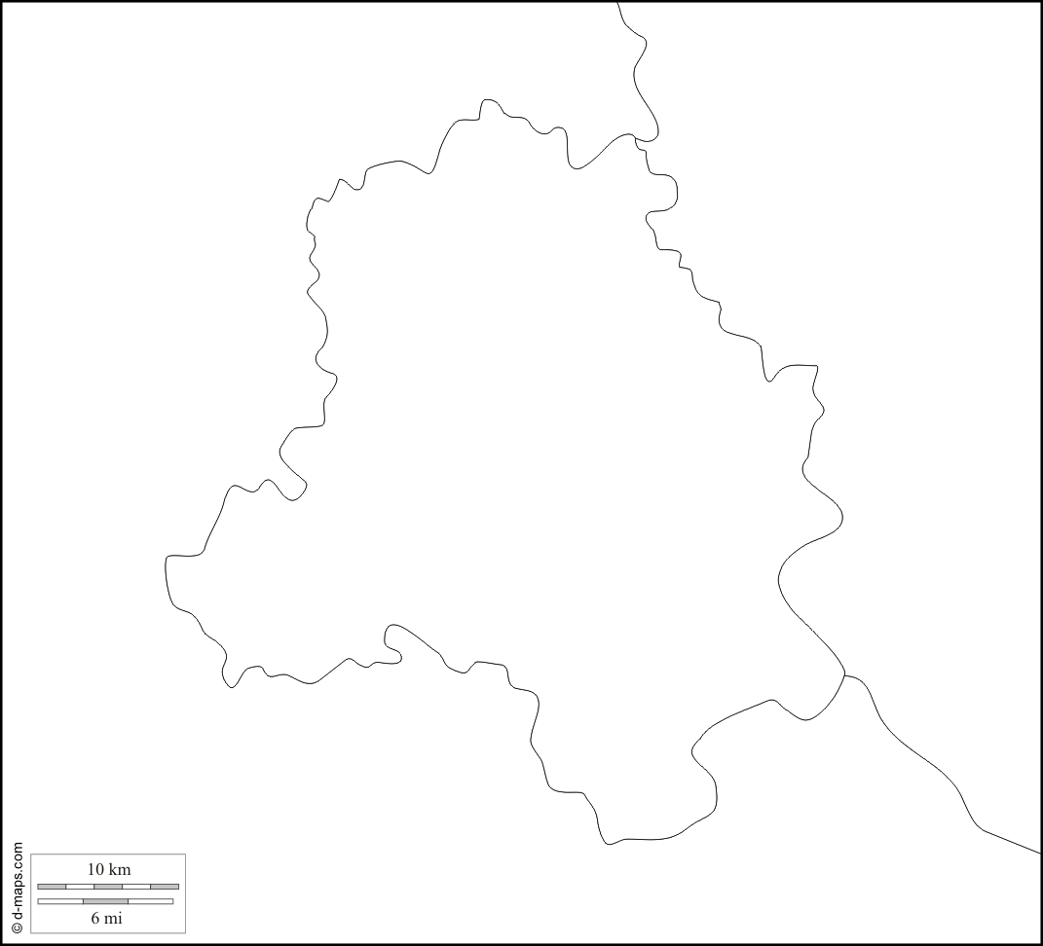
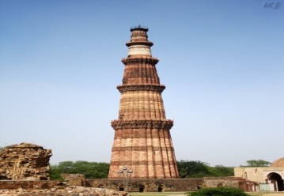
Seamless Integration
NOCs Integrated
Internal Agencies
Law Dept
Town Planning Dept
External Agencies
Delhi Fire Services (DFS)
Chief Inspector of Factories (CIF)
Delhi Pollution Control Committee (DPCC)
Delhi Jal Board (DJB)
Dept. of Forest (Forest)
Delhi Urban Arts Commission (DUAC)
Delhi Metro Rail Corporation (DMRC)
Airports Authority of India (AAI)
Heritage Conservation Committee (HCC)
National Monuments Authority (NMA)

Slide 10
Steps taken to improve transparency and ease
Commencement Intimation has been dispensed with
Total time taken from sanction to Occupancy Certificate has been reduced from 157.5 to less than 60 days
Payment of fee is online by Net banking, Debit /Credit Card and RTGS/NEFT, etc.
Single payment is made towards fees before release of plan.
Applicant need not visit office of any of the agency for NOC

Slide 11
Steps taken to improve transparency and ease
All FAQs, Circulars and Checklists are available on the websites
Dynamic Dashboard of all cases projected online on Real-Time basis
Risk Based procedures for Sanction / Plinth Inspection / Completion.

Slide 12
Feedback Fora
WhatsApp group for the architects and professionals to address day to day queries
Stakeholders’ meetings are held every Wednesday to get the feedback for further improving the system
Facebook page ‘MCD Ease of Doing Business’ Twitter handle
Star rating of the online system by architects, 5 star rating have been given in 2282 cases out of 3503 cases
Every change in application status is notified by SMS and e-mail

Slide 13
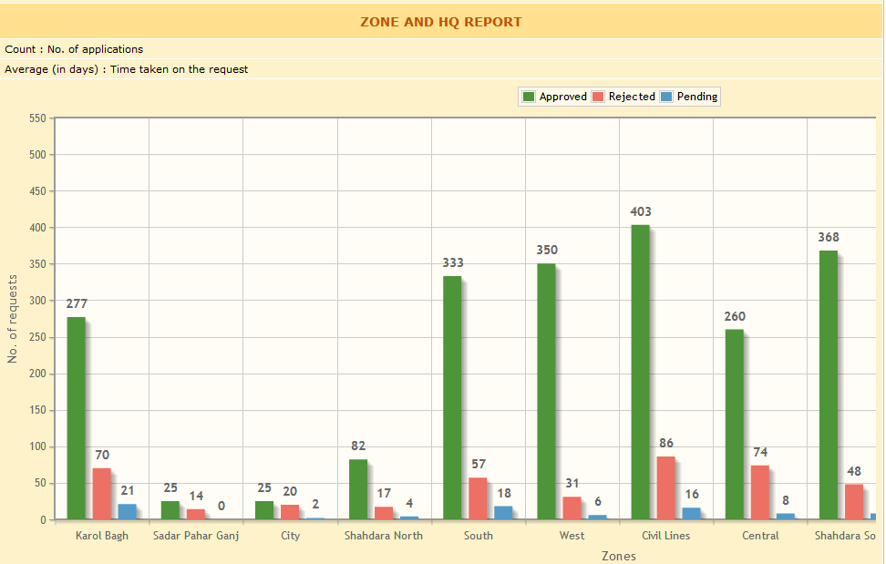
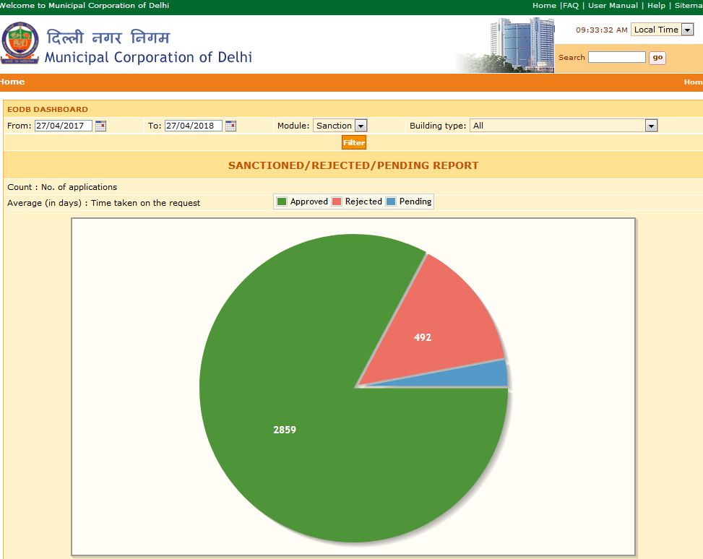
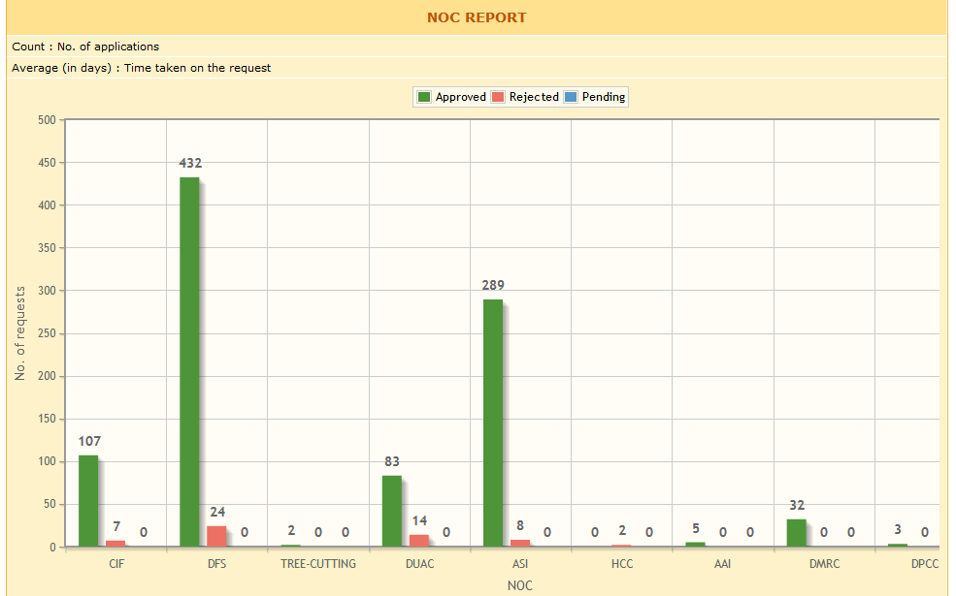
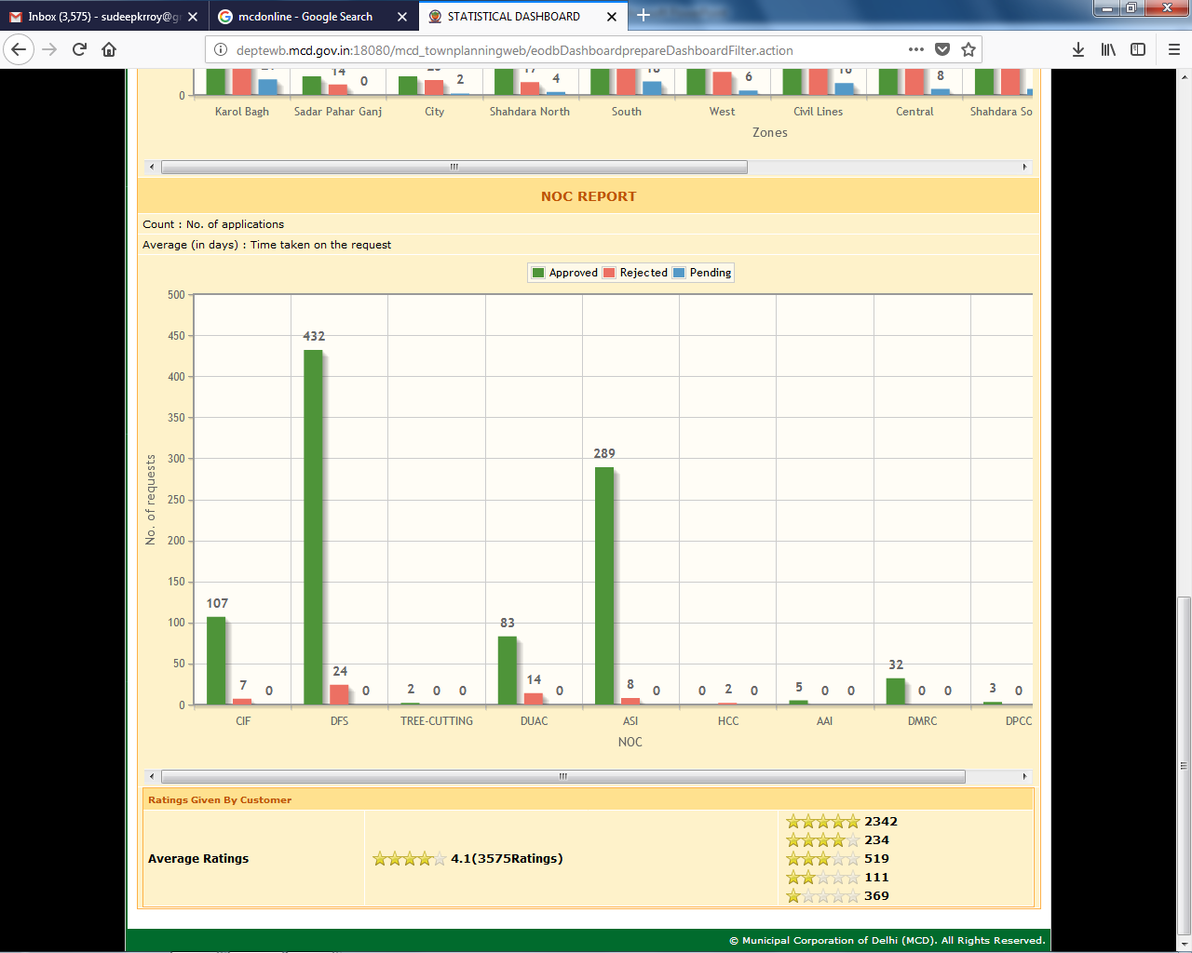
Dynamic Dashboards: Approvals & NOCs
Back to “Ease process”

Slide 14
Results: At a Glance (01/04/17 to 26/04/2018)
Plans received | 3597 Nos.
Plans Sanctioned | 2994 Nos.
Plans under process | 74 Nos.
Plans rejected | 511 Nos.
Plans sanctioned within 1 day | 799 Nos
Plans sanctioned within 7 days | 981 Nos
Plans sanctioned within 14 days | 510 Nos
Deemed approvals of Plans | 109 Nos.
Average Time for sanction | 9.86 days
Deemed NOCs done | 109 Nos
C1/C2 Issued Online | 700 Nos
C1/C2 Deemed | 33 Nos
Completion Issued Online | 238 Nos
Completion Deemed Online | 10 Nos
Average time for completion | 20.36 days
No. of Joint Inspections Done | 3 Nos

Slide 15
Thank You

